Slide 1
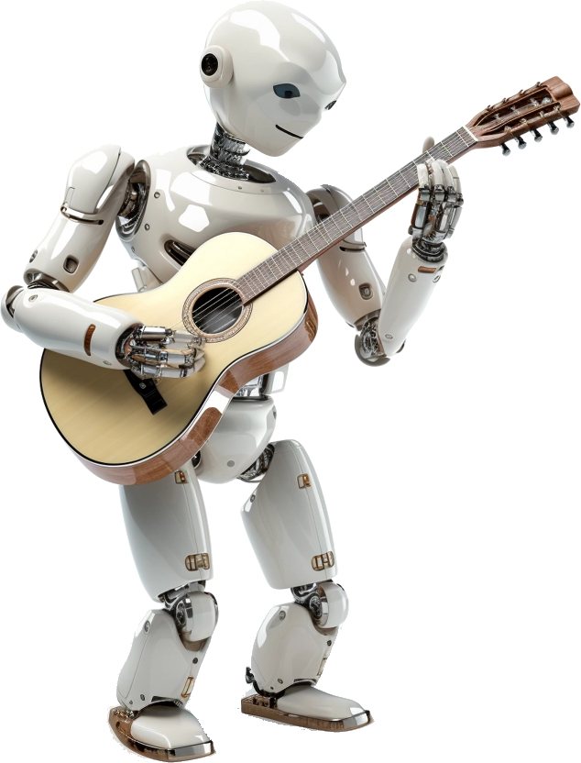
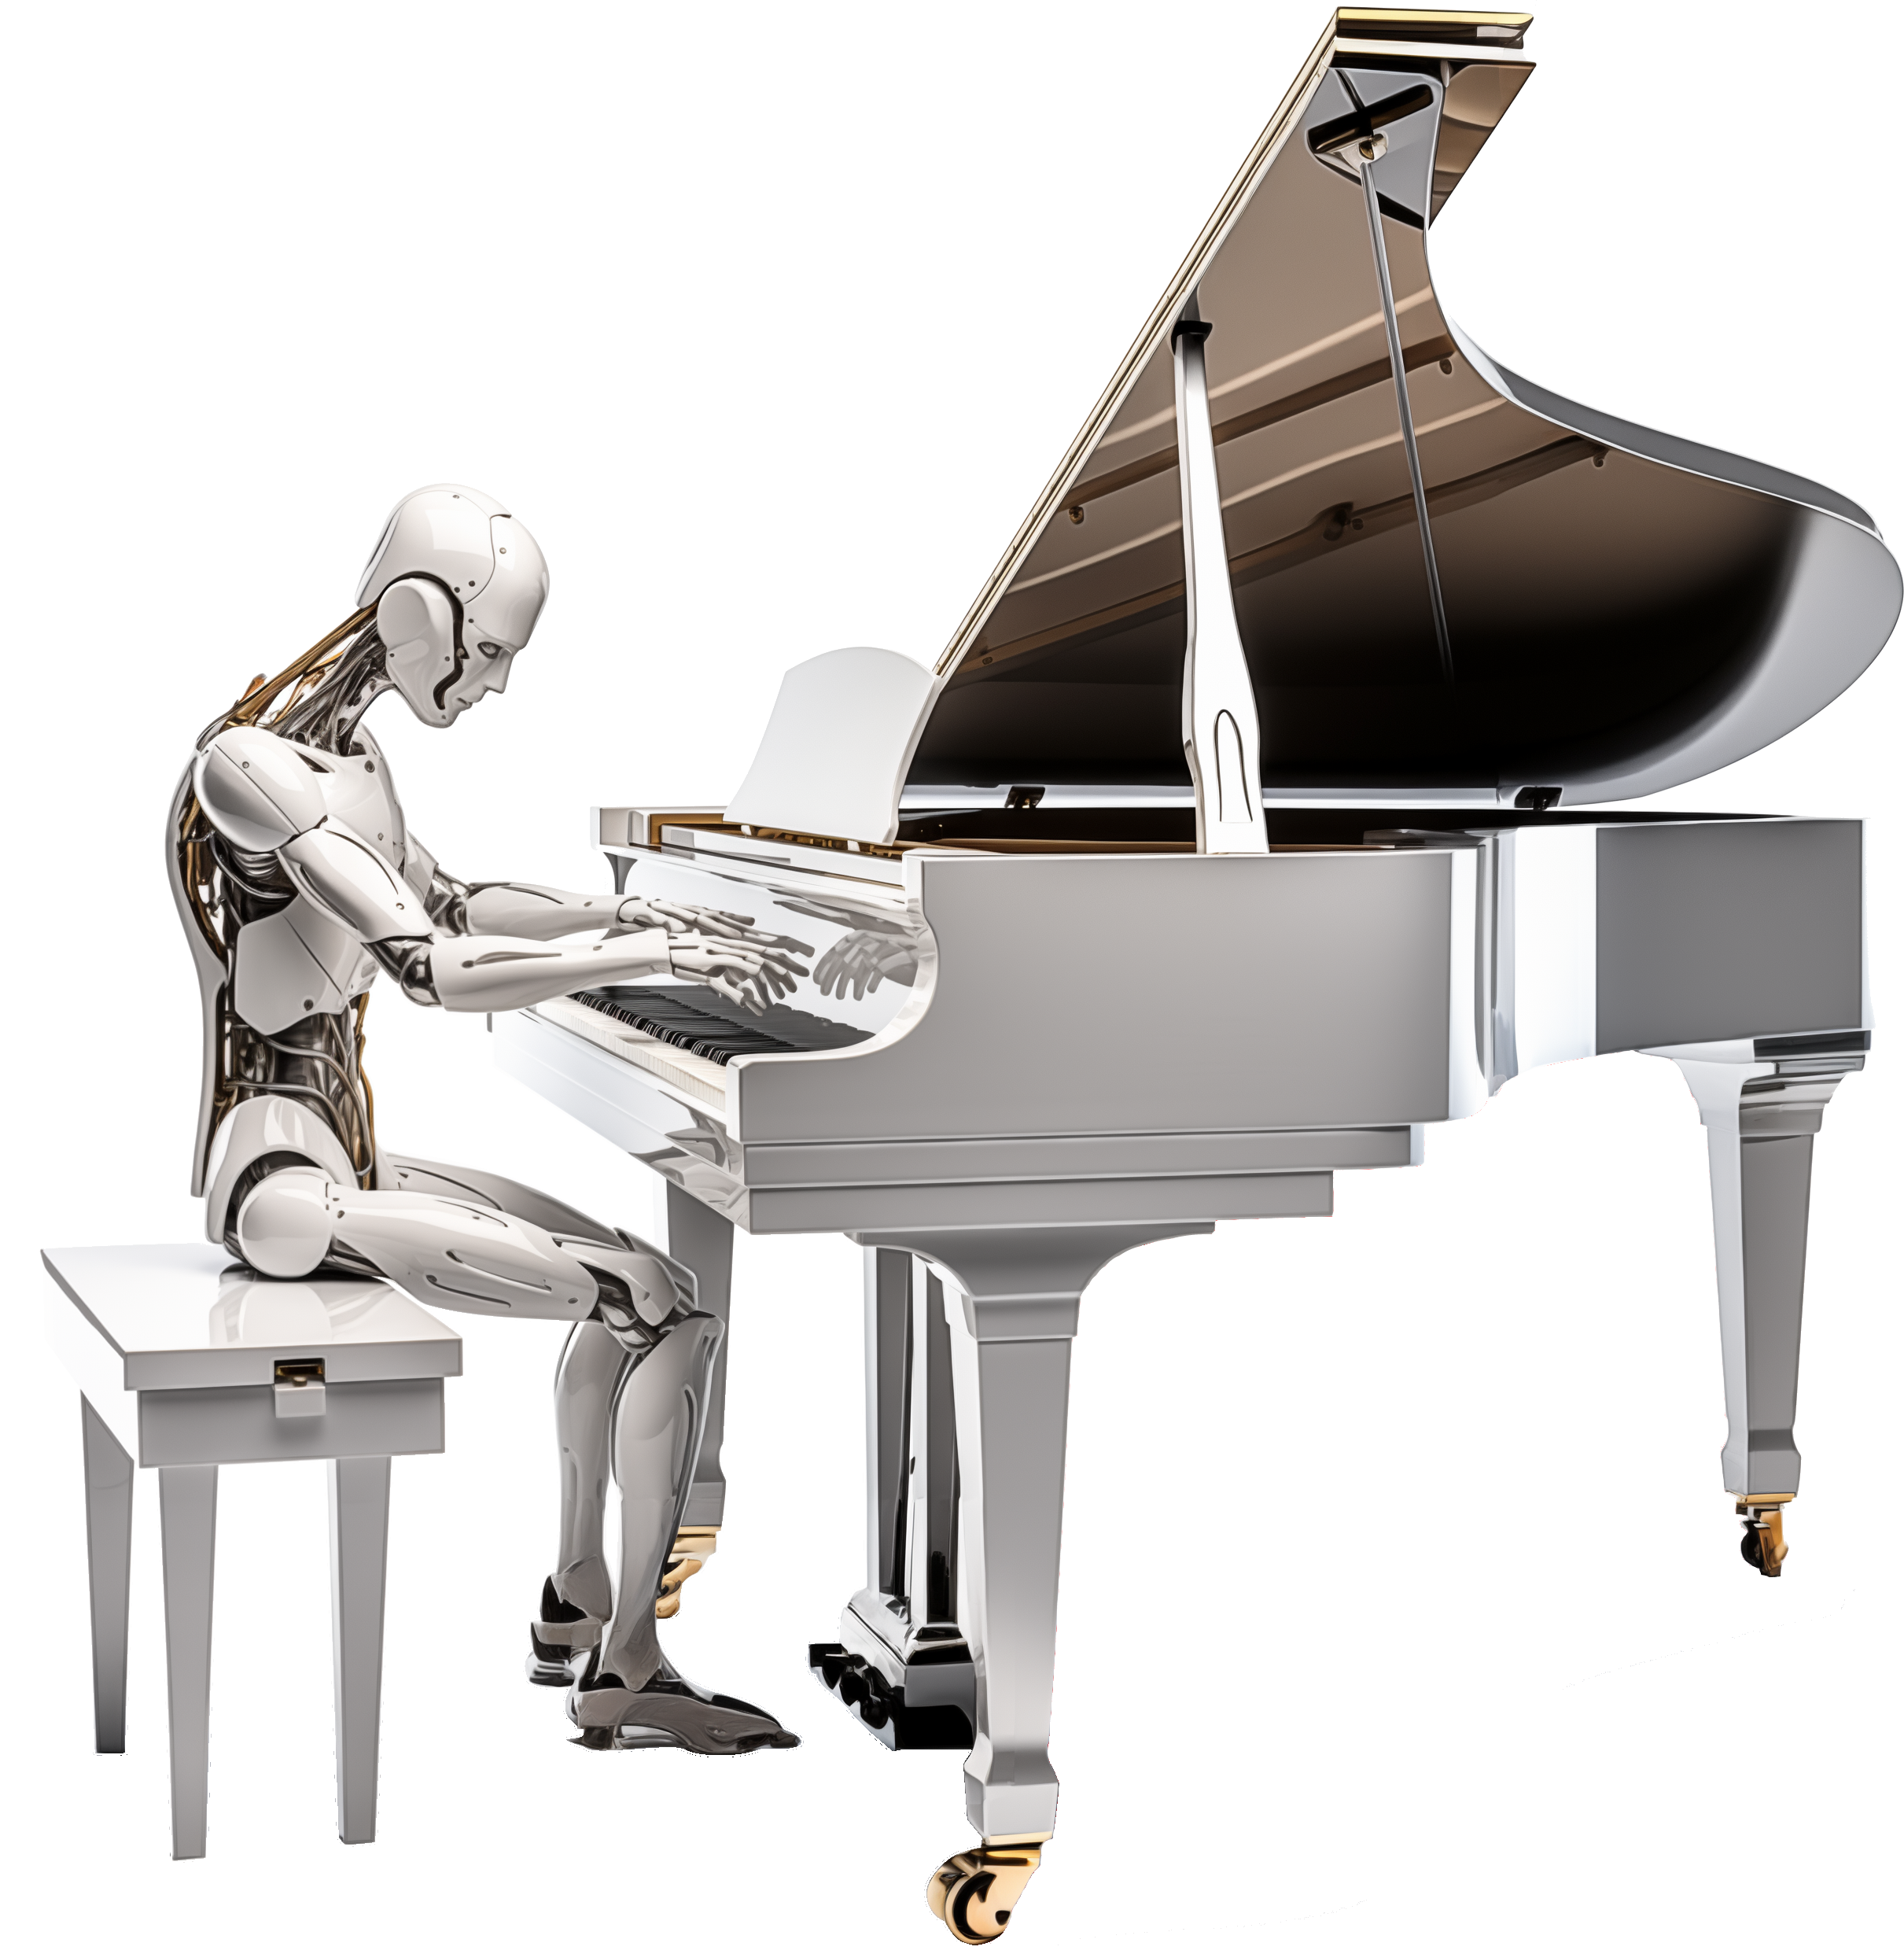
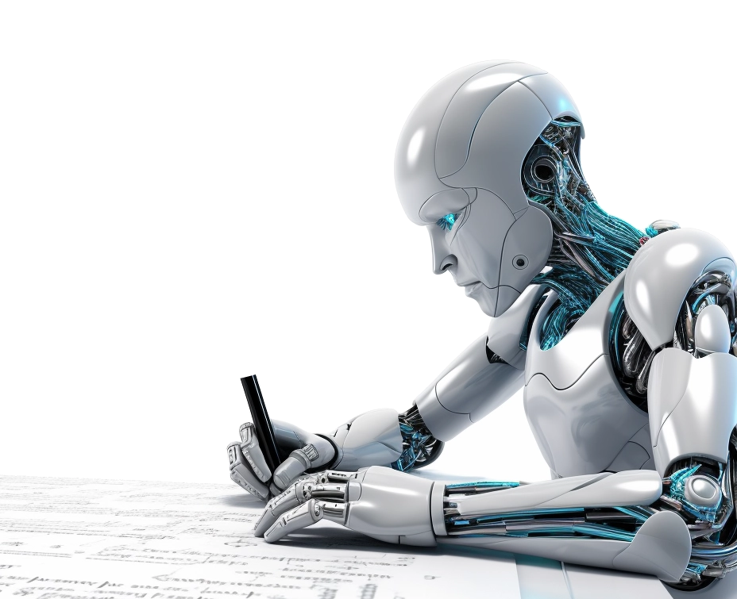
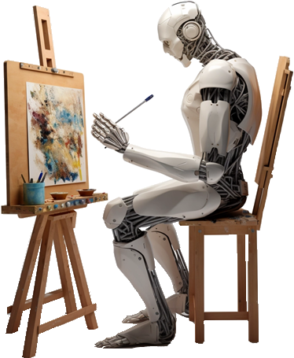
Generative Artificial Intelligence
Paul Dubois
Info@Lèze

Slide 2

Creating new words

Slide 3
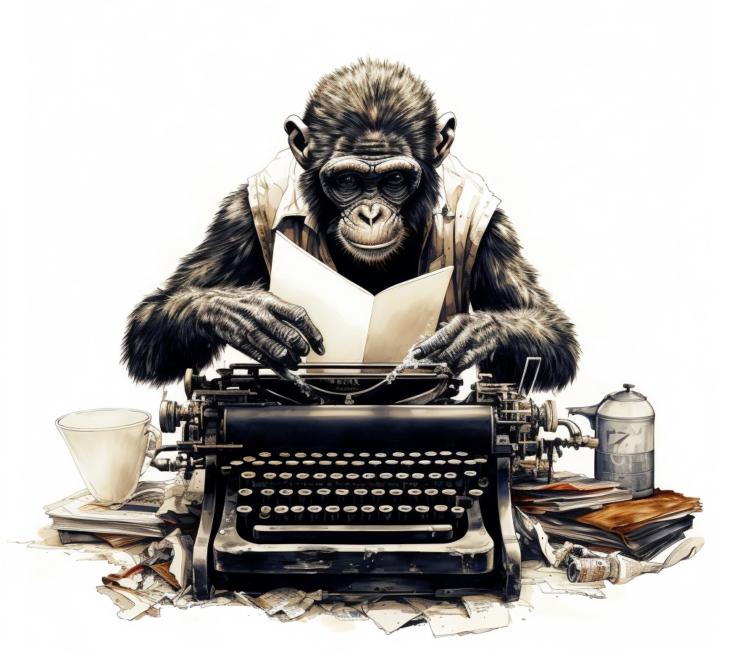
Method 1:
Randomly type on a keyboard

Slide 4
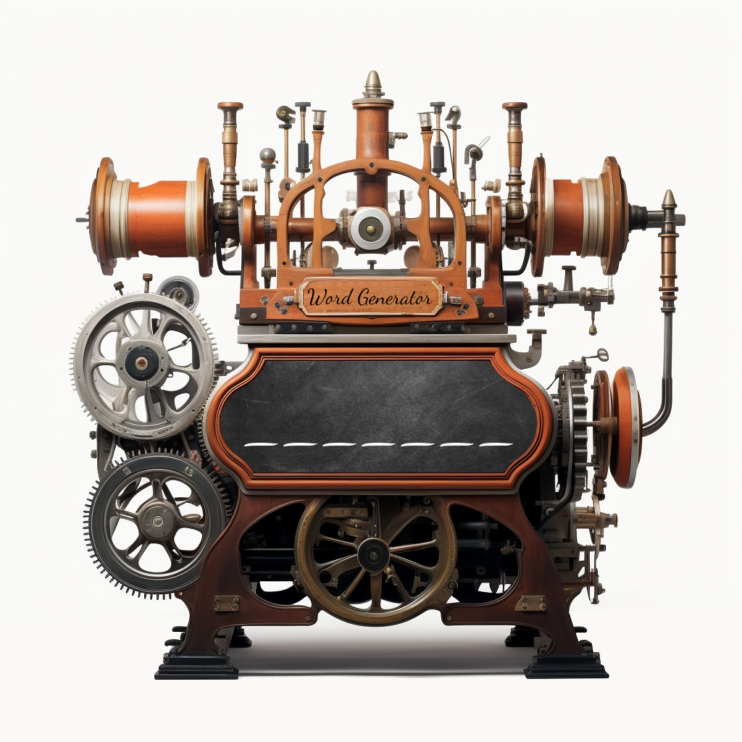

Words Generator Machine 1
https://pauldubois98.github.io/GenerativeAI/word_generator1.html

Slide 5
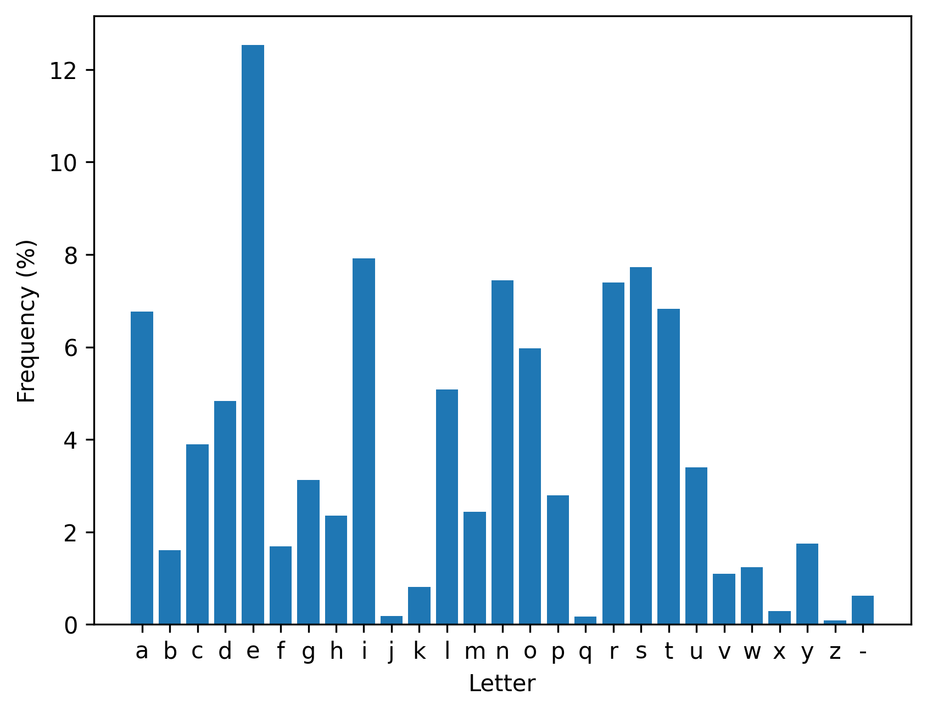
Letters usage (in dictionary)

Slide 6
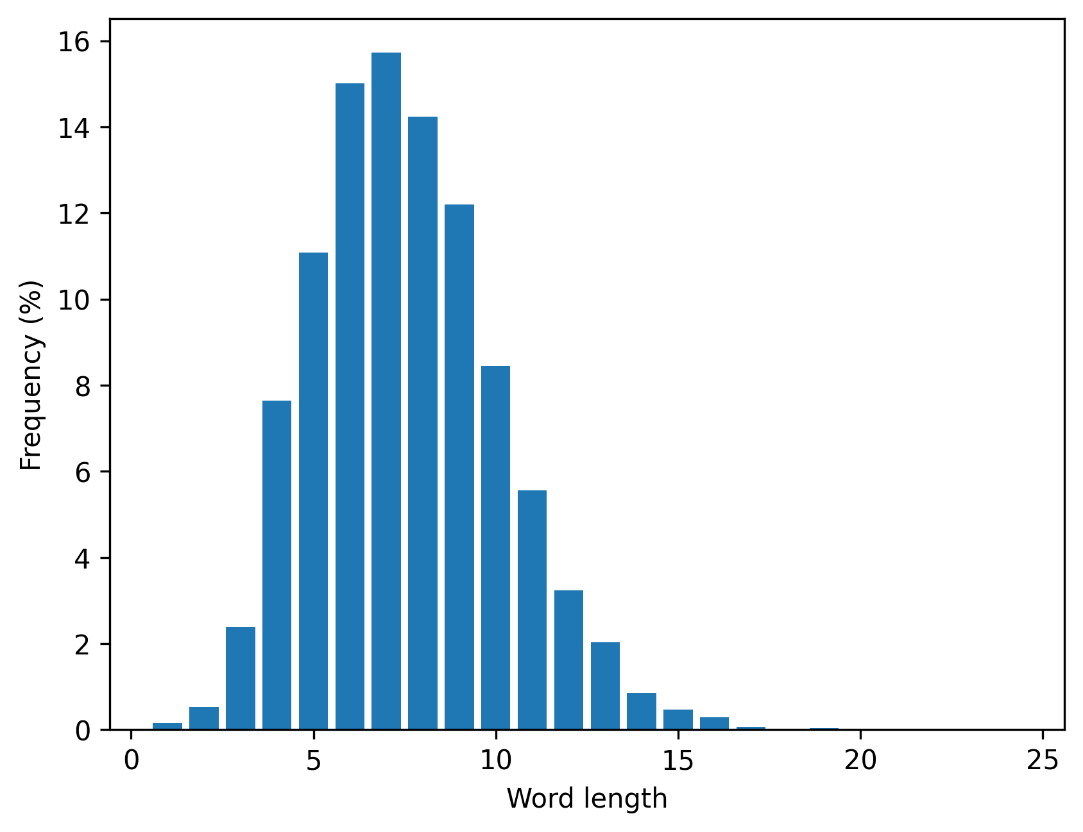
Words lengths (in dictionary)

Slide 7

Method 2:
Type on a weighted keyboard

Slide 8
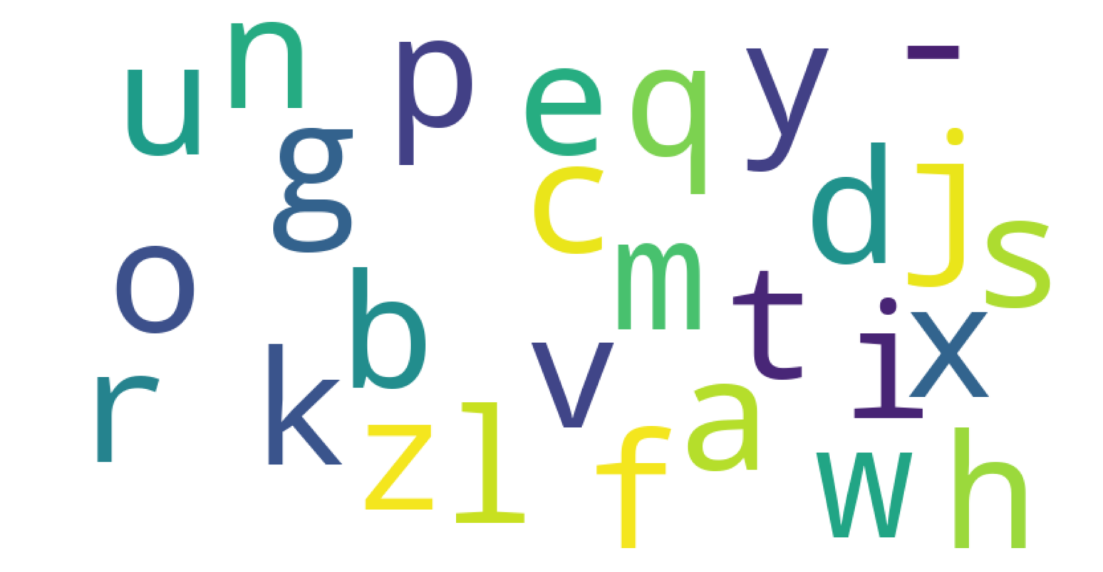
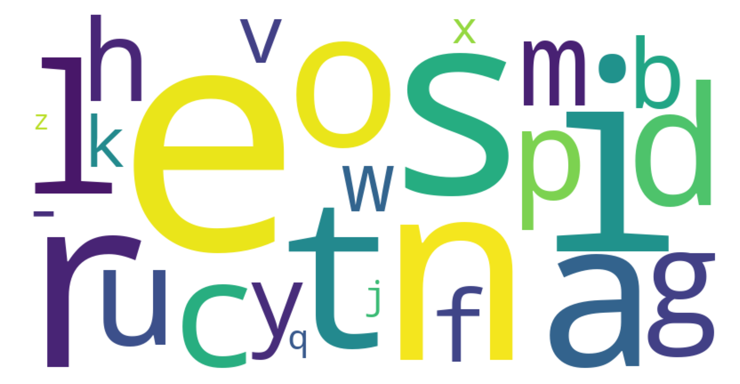
What is a “weighted” keyboard?
Non-weighted
Weighted

Slide 9
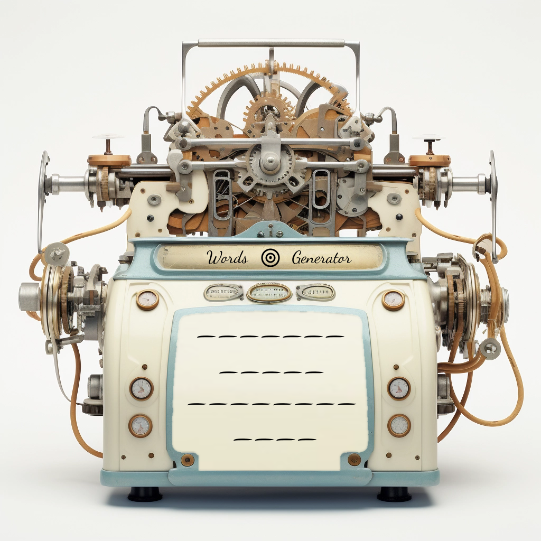

Words Generator Machine 2
https://pauldubois98.github.io/GenerativeAI/word_generator2.html

Slide 10
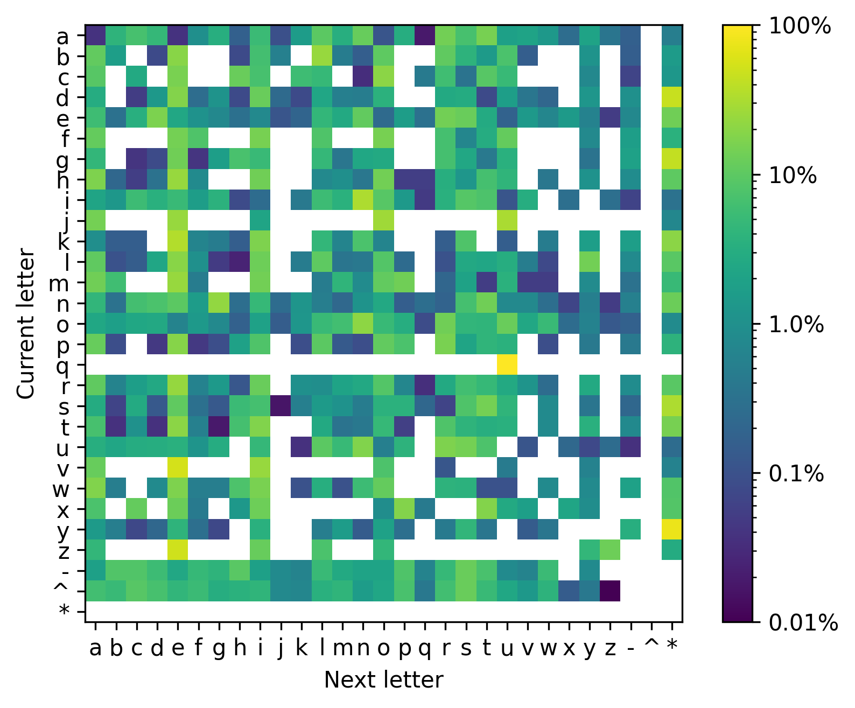
Markov Heatmap

Slide 11
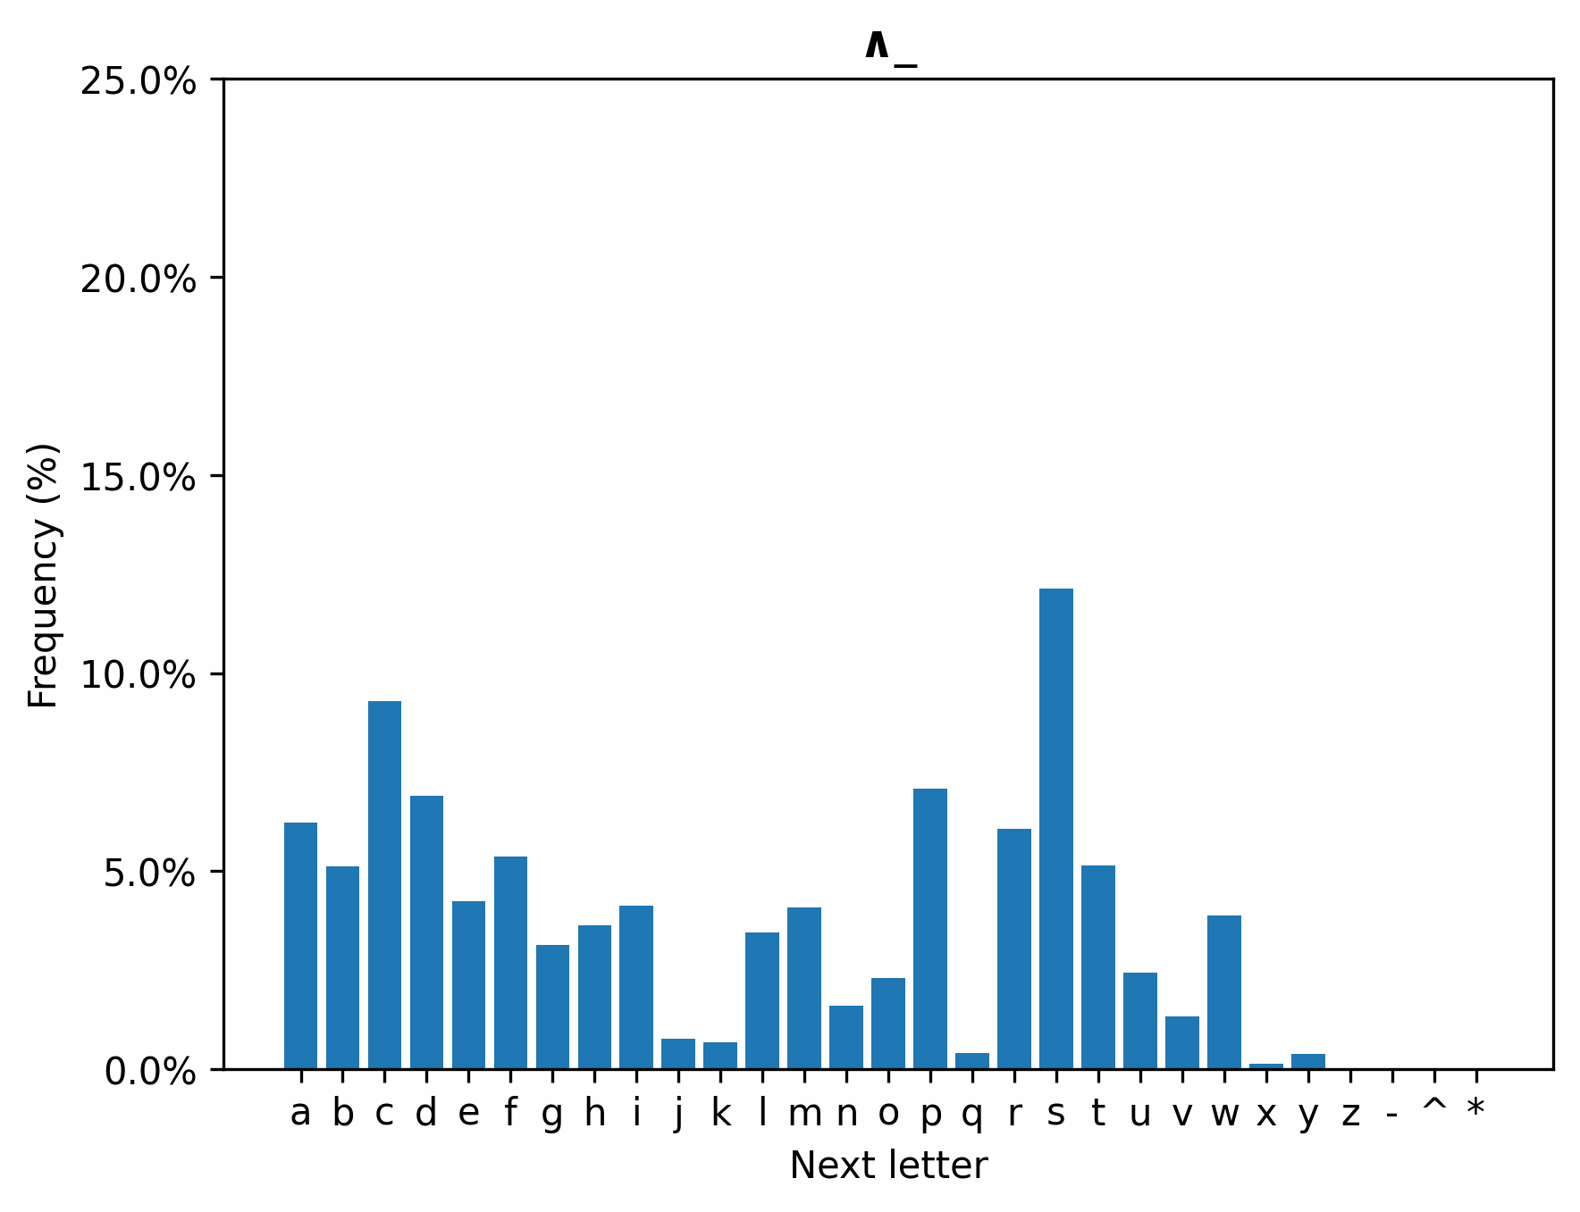
Next Letter

Slide 12
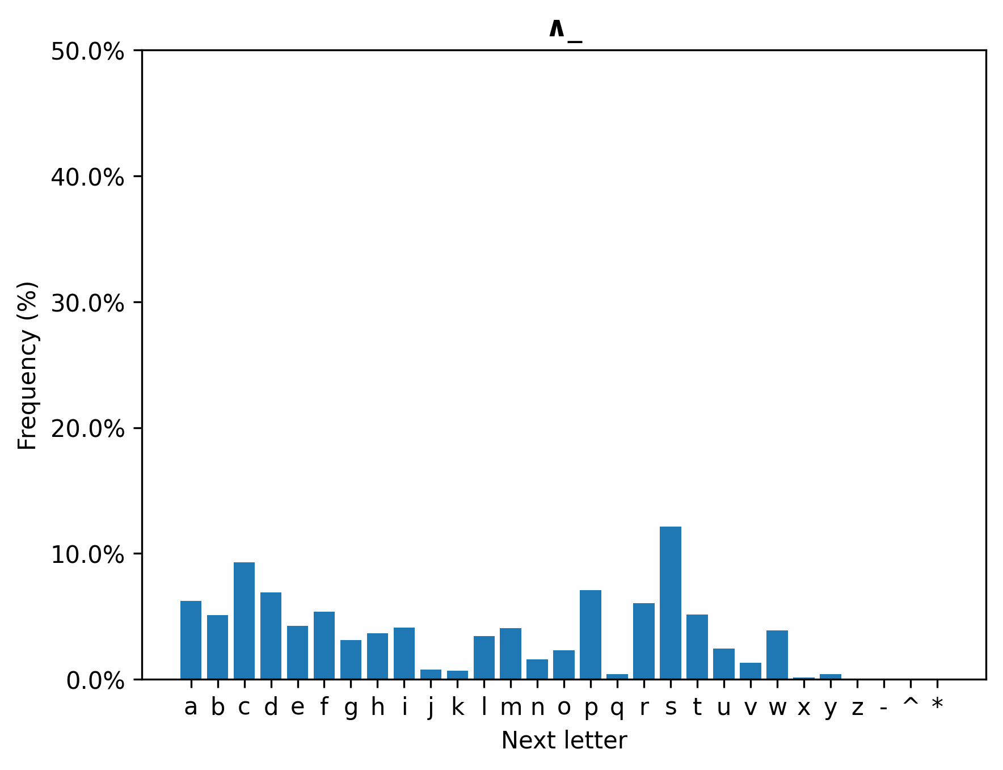
Next Letter (2)

Slide 13
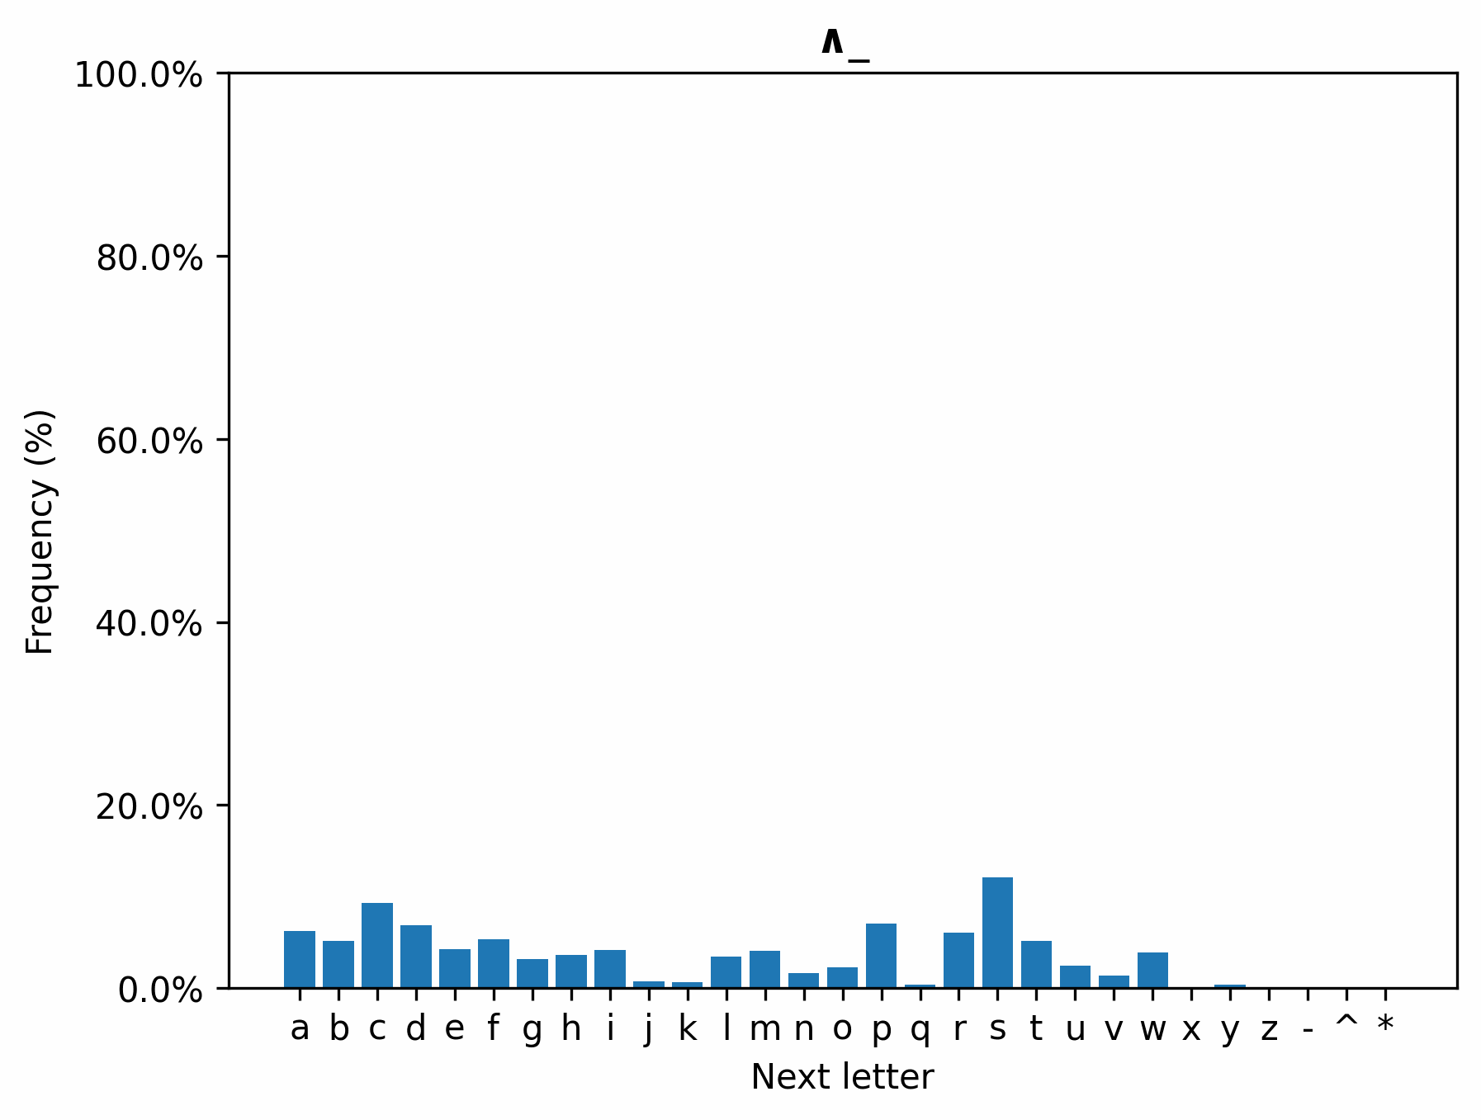
Next Letter (3)

Slide 14
Next Letter (4)

Slide 15
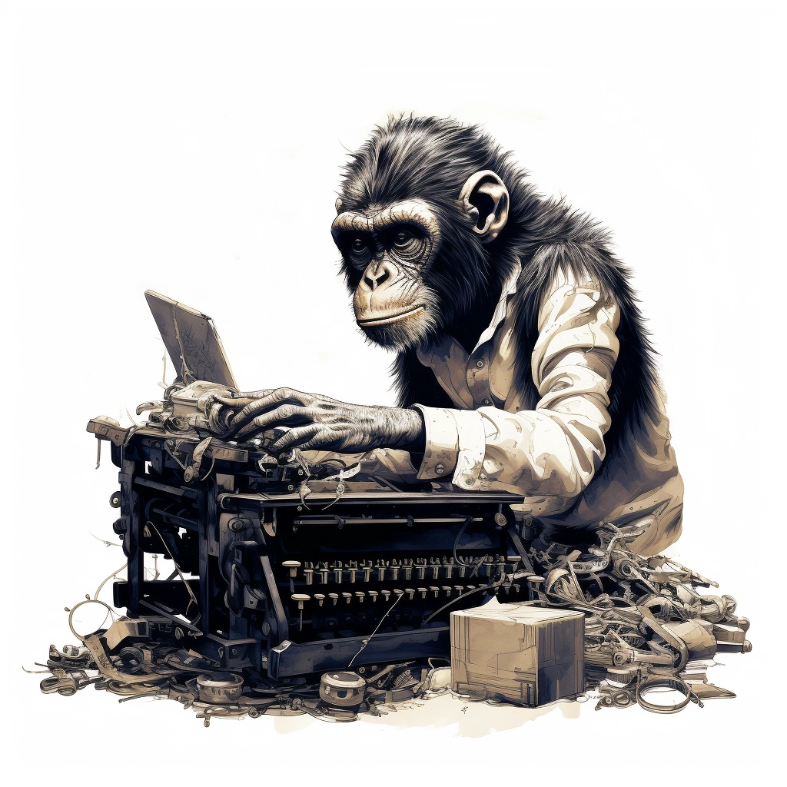
Method 3:
Dynamically weighted keyboard

Slide 16
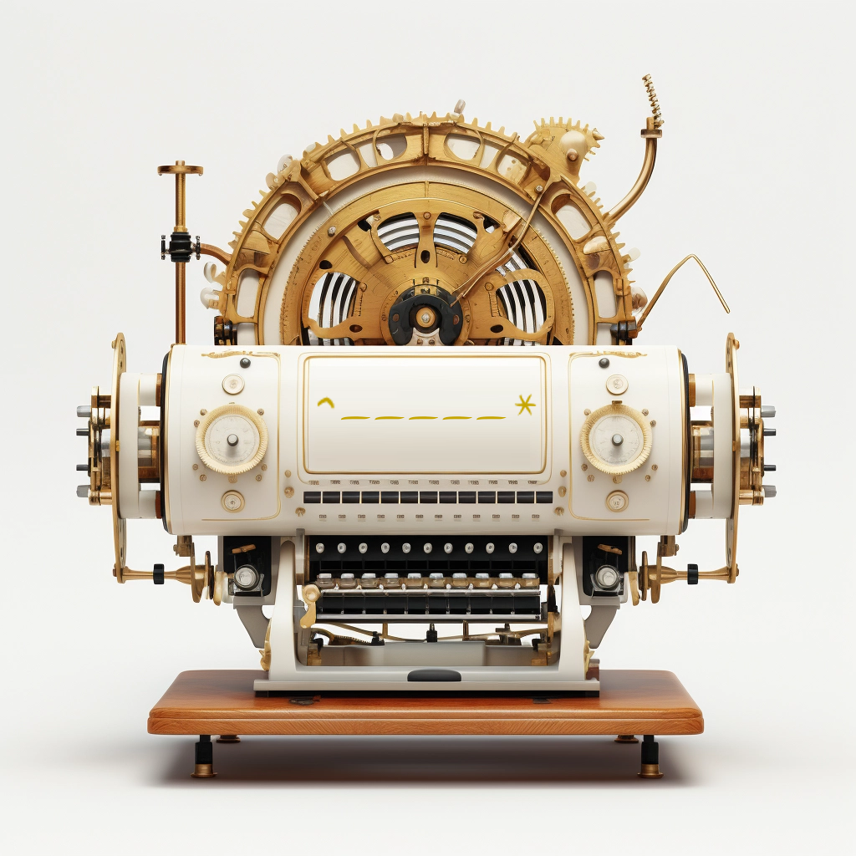

Words Generator Machine 3
https://pauldubois98.github.io/GenerativeAI/word_generator3.html

Slide 17
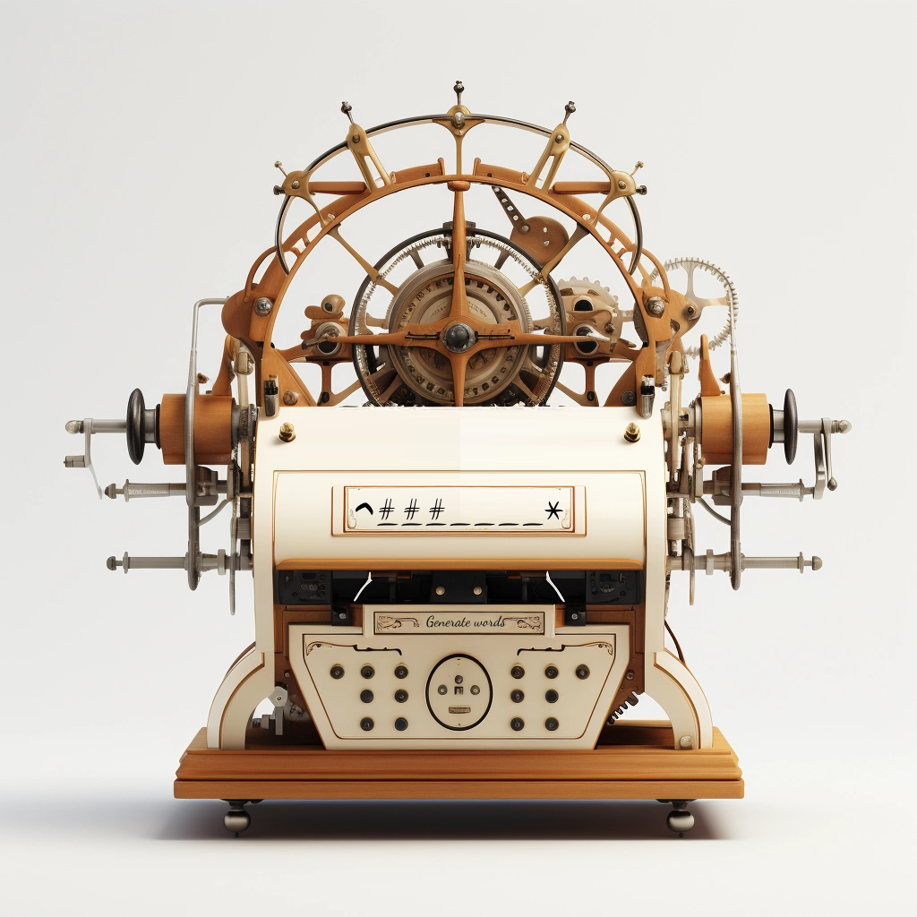

Custom Words Generator Machine 3 (bis)
https://pauldubois98.github.io/GenerativeAI/next_letters.html

Slide 18
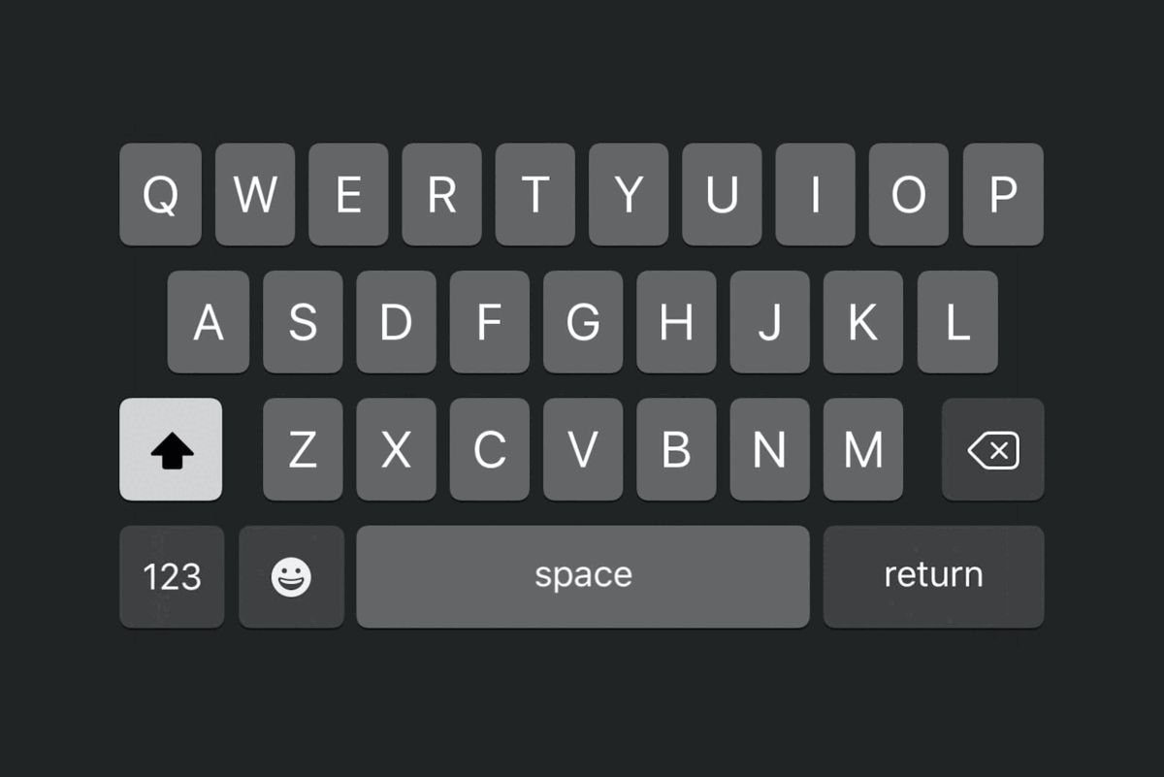
This is useful!

Slide 19

Predict letters

Slide 20
Complete the word…
…with context
…h␣?
…e␣?
…m␣?
…a␣?
…t␣?
…i␣?
…c␣?
…s␣?
^math␣?
^mathe␣?
^mathem␣?
^mathema␣?
^mathemat␣?
^mathemati␣?
^mathematic␣?
^mathematics␣?

Slide 21
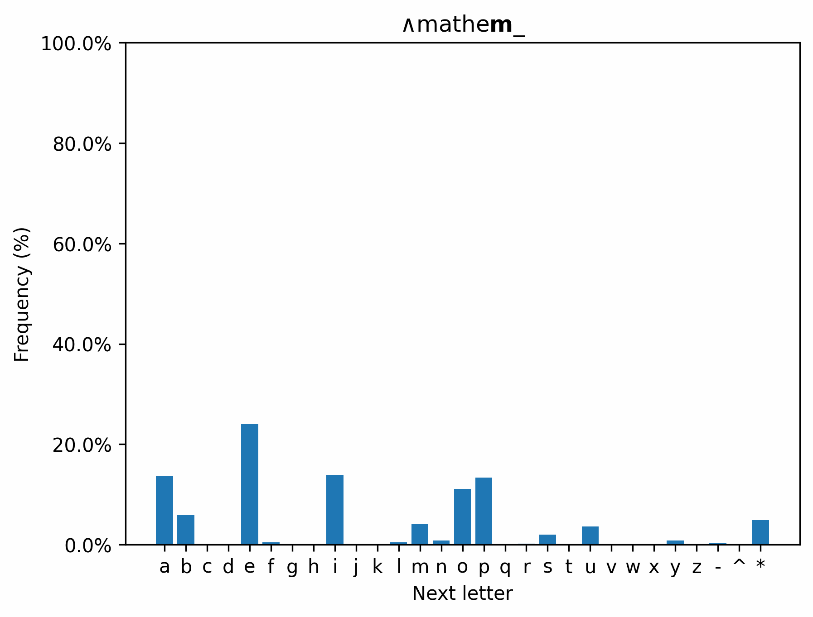
Context really helps!

Slide 22
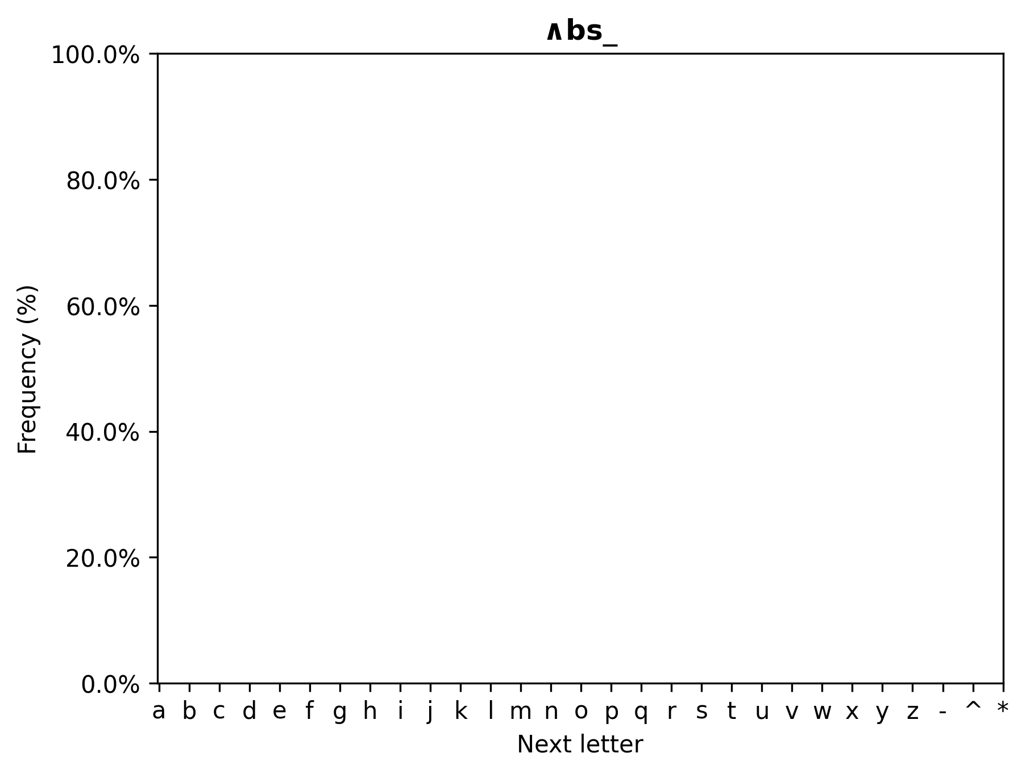
Dictionary search

Slide 23
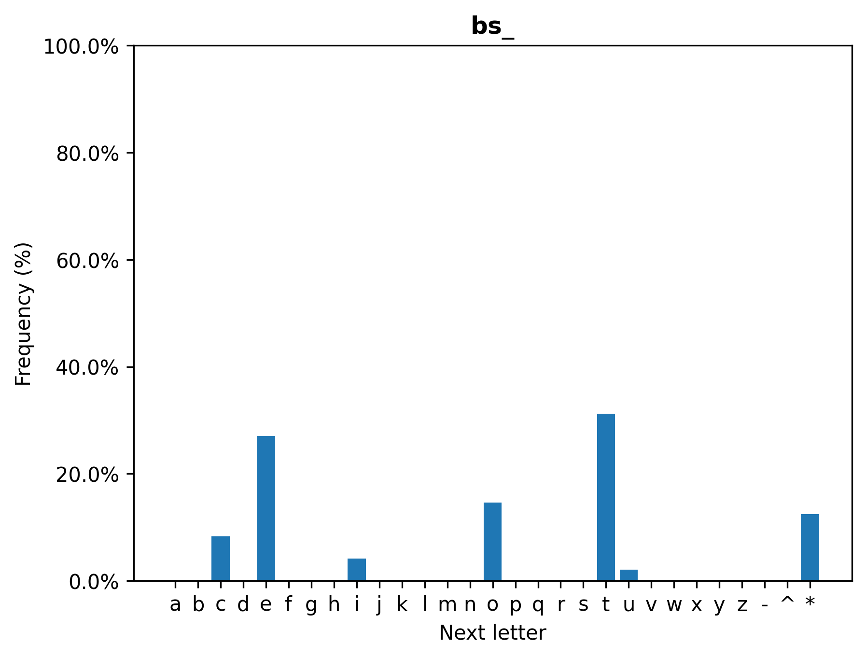
Dictionary search

Slide 24
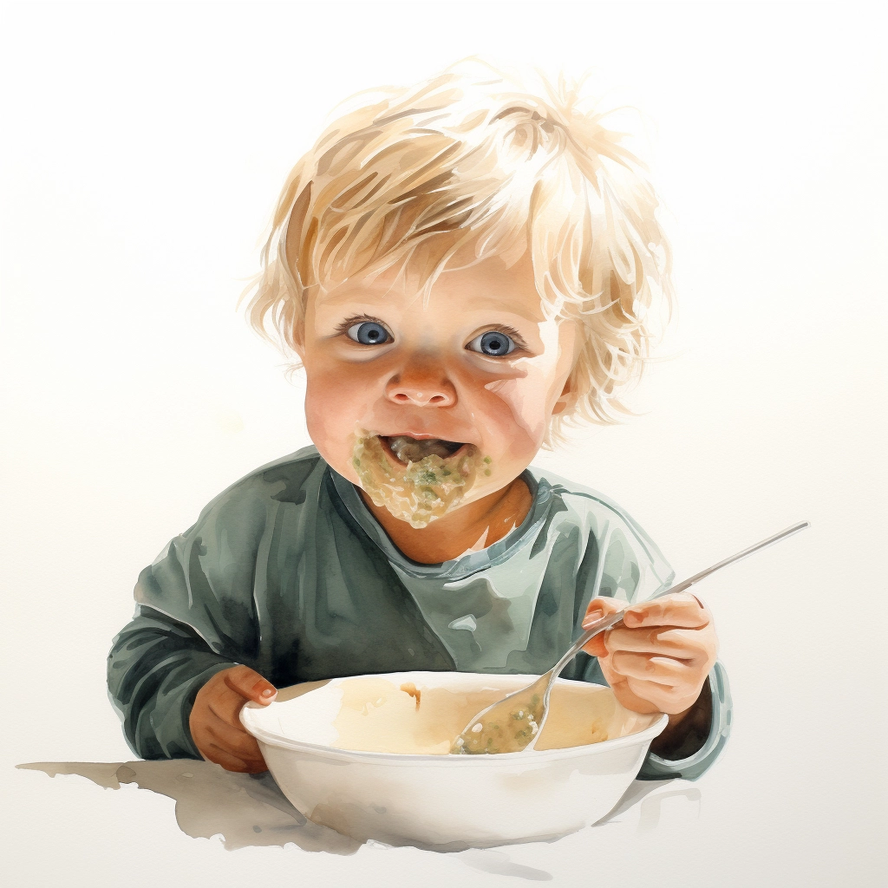
How do babies learn to eat purée?

Slide 25
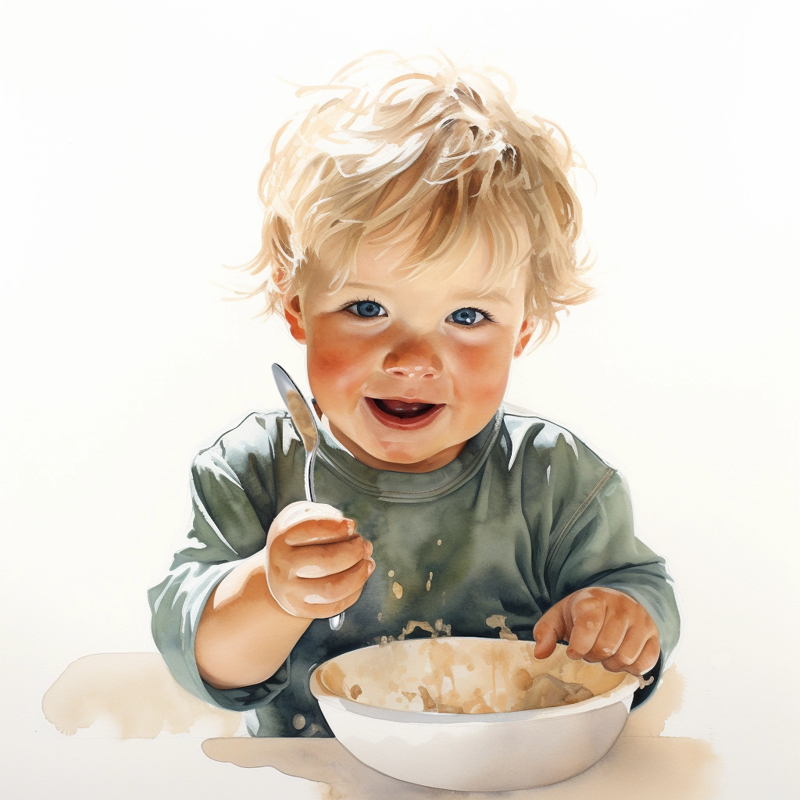
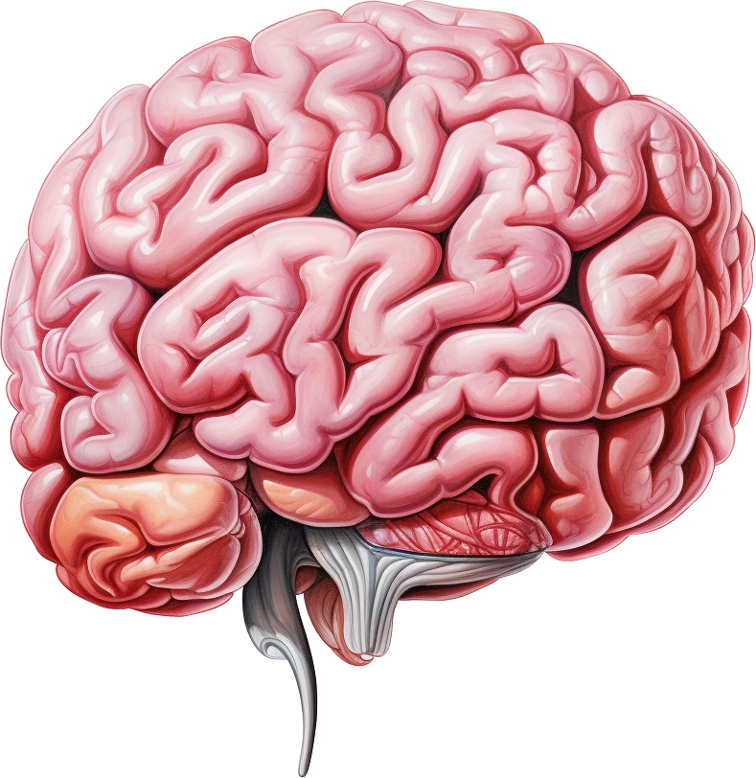

The brain

Slide 26
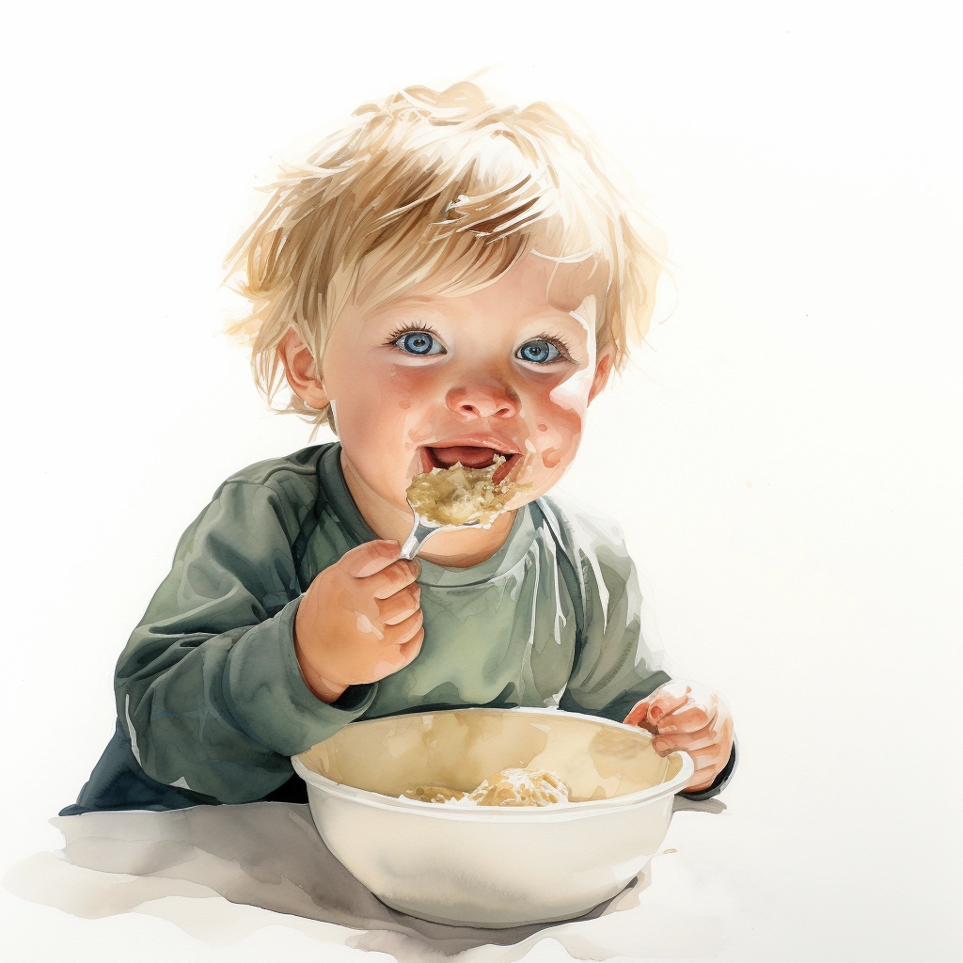
The brain

Slide 27
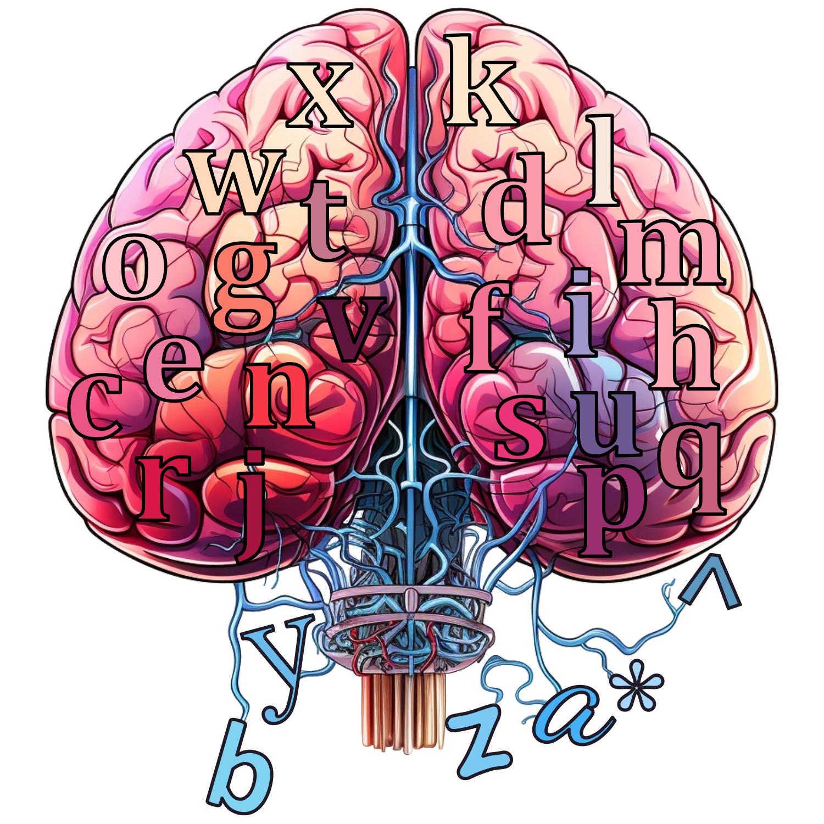
A brain to predict the next letter

Slide 28
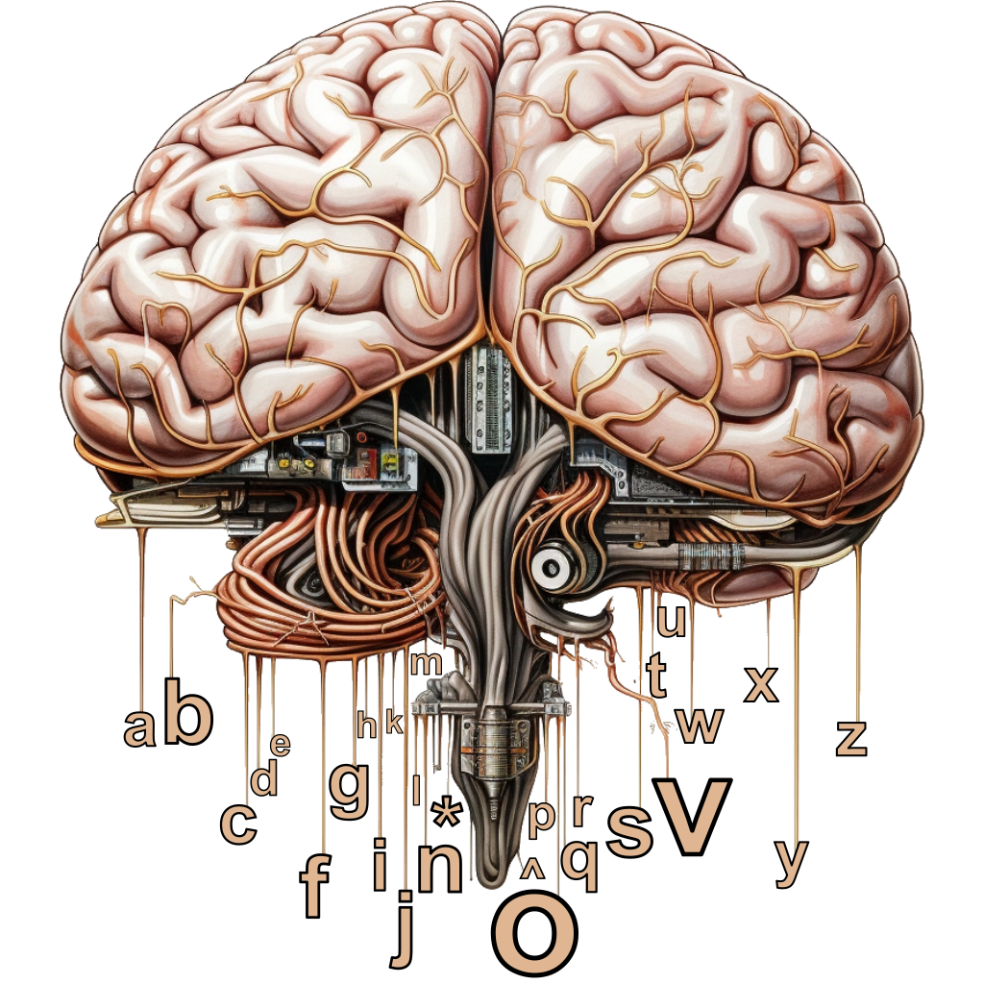
Artificial Brain
^physi_
c

Slide 29
Artificial Brain
b
a
^
*
a
a
b
b
c
c
…
…
z
z

Slide 30
Artificial Brain
^
c
a
b
*
^
^
^
^
*
a
a
a
a
a
b
b
b
b
b
c
c
c
c
c
…
…
…
…
…
z
z
z
z
z

Slide 31
Predicting the next letter of the alphabet
a → b
b → c
c → d
d → e
e → f
f → g
g → h
h → i
i → j
j → k
k → l
l → m
m → n
n → o
o → p
p → q
q → r
r → s
s → t
t → u
u → v
v → w
w → x
x → y
y → z
z → -
- → *

Slide 32
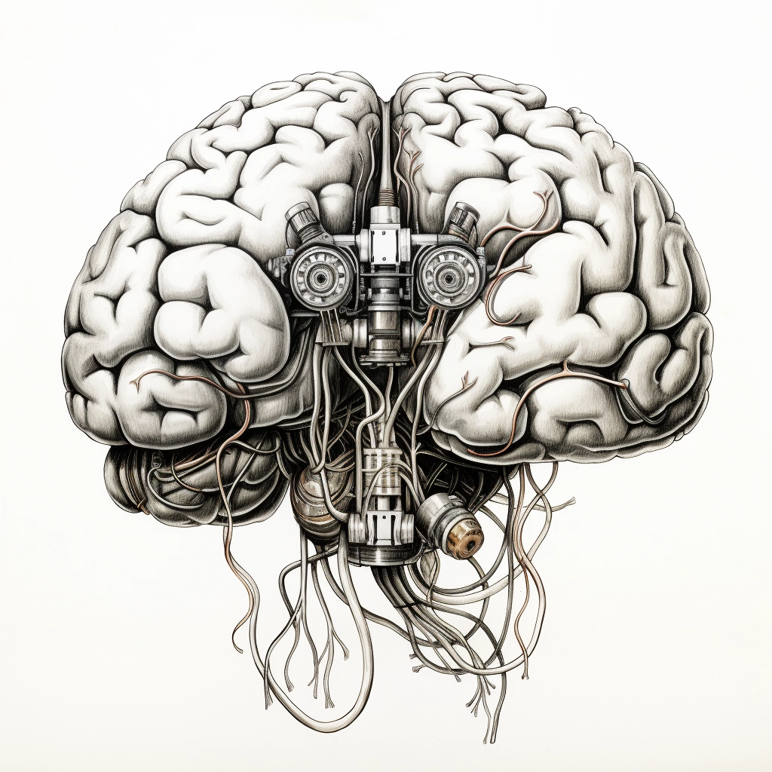

Predicting the next letter of the alphabet
https://pauldubois98.github.io/GenerativeAI/futur_letters.html?data=test

Slide 33
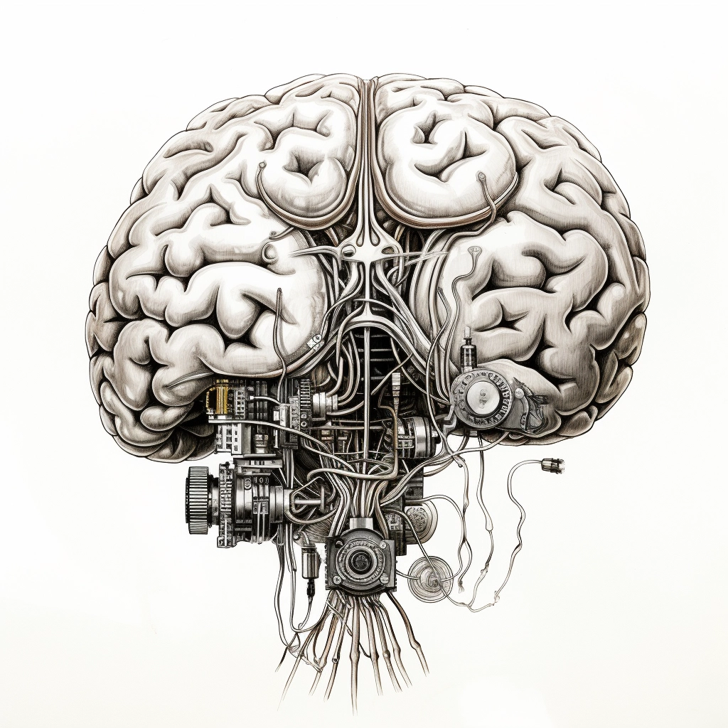

Predicting the correct next letter
https://pauldubois98.github.io/GenerativeAI/futur_letters.html

Slide 34
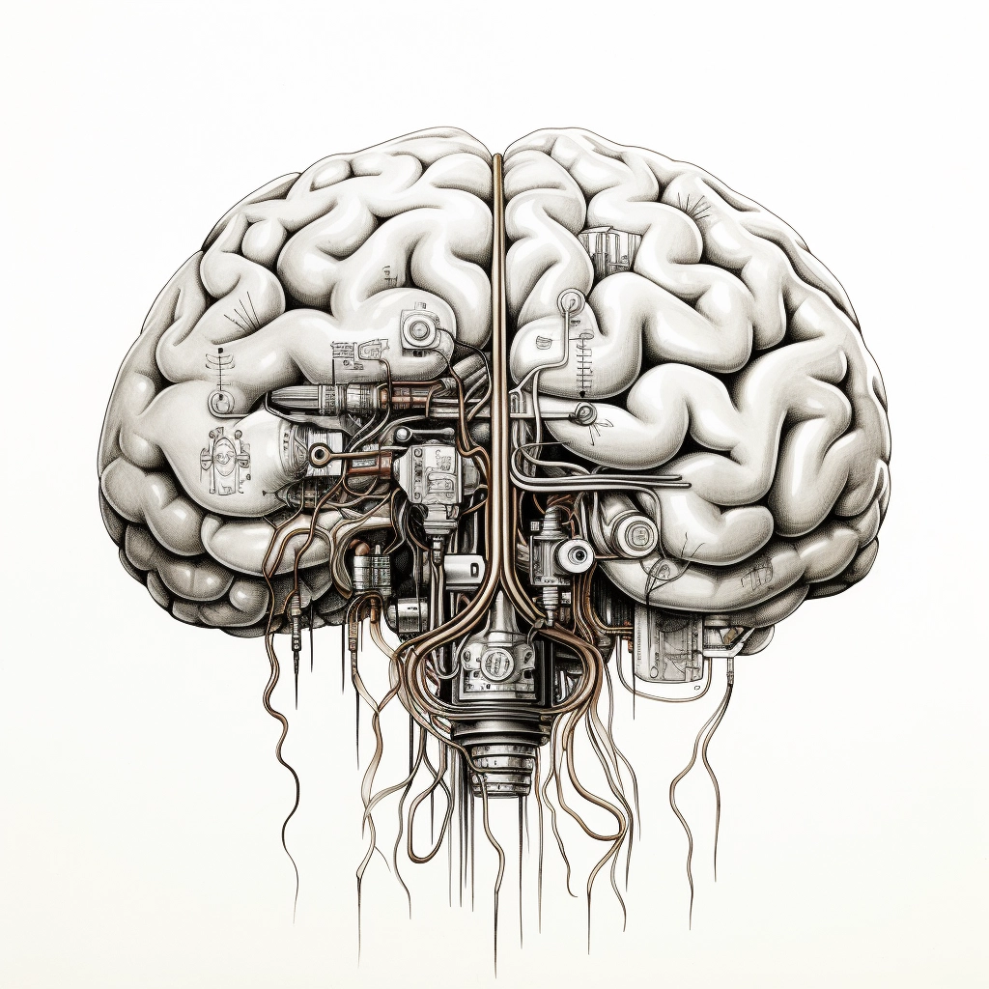

Layers Architecture
https://pauldubois98.github.io/GenerativeAI/ultimate_letters.html?data=test

Slide 35
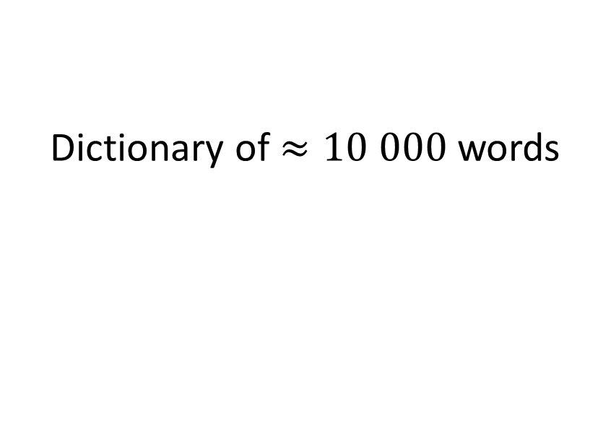
Training dataset
Ours
ChatGPT
Dictionary of $≈10 000$ words
FAQ forums
Wikipedia
Press articles
Scientific articles
School textbooks
…

Slide 36
Training resources
Ours
ChatGPT
< 10 minutes
On 1 smartphone
(or a laptop)
“34 days”
On 1023 supercomputer
(A100 GPUs)

Slide 37
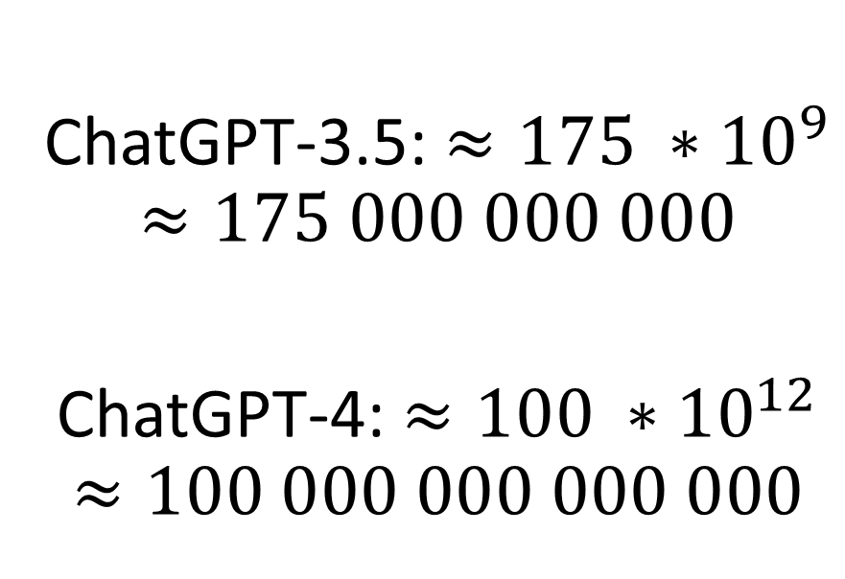
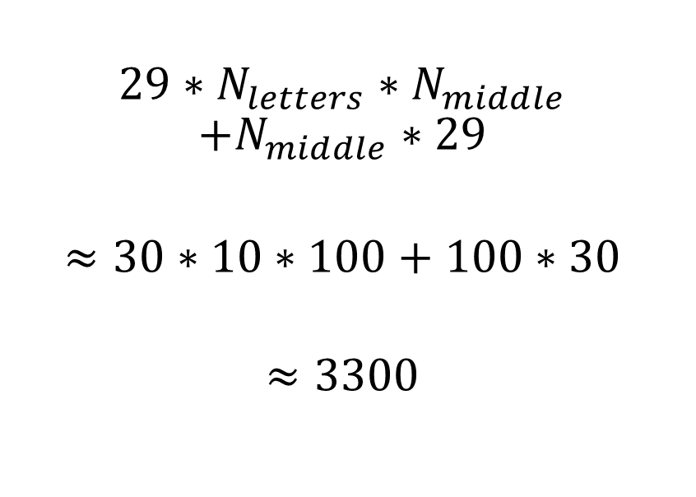
Number of parameters
Ours
ChatGPT
$$29∗N_{letters}∗N_{middle}$$
$$+N_{middle}∗29$$
$$≈30∗10∗100+100∗30$$
$$≈3300$$
ChatGPT-3.5: $≈175 ∗{10}^{9}$
$$≈175 000 000 000$$
ChatGPT-4: $≈100 ∗{10}^{12}$
$$≈100 000 000 000 000$$

Slide 38
Using ChatGPT
“I buy a coffee and a bread for 5€.
The coffee is 1€ more expensive that the bread.
How much costs the bread?”
“The bread is 2€”
“I buy a coffee and a bread for 5€.
The coffee is 2€ more expensive that the bread.
How much costs the bread?”
“The bread is 3€”

Slide 39
Using ChatGPT with good prompt
“I buy a coffee and a bread for 5€.
The coffee is 1€ more expensive that the bread.
How much costs the bread?
Explain the reasoning.”
“B+C = 5 ; C = B+1
so 2B+1 = 5 i.e., B = 2.
The bread is 2€”
“I buy a coffee and a bread for 5€.
The coffee is 2€ more expensive that the bread.
How much costs the bread?
Explain the reasoning.”
“B+C = 5 ; C = B+2
so 2B+2 = 5 i.e., B = 1.5.
The bread is 1.5€”

Slide 40
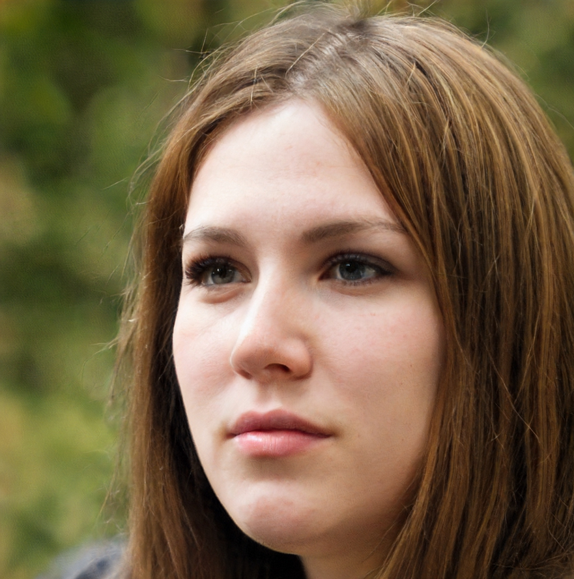

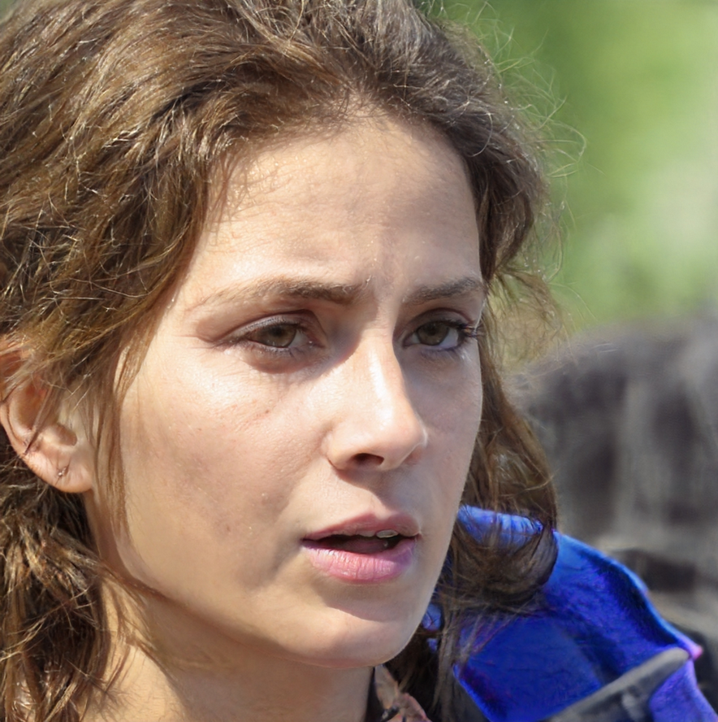
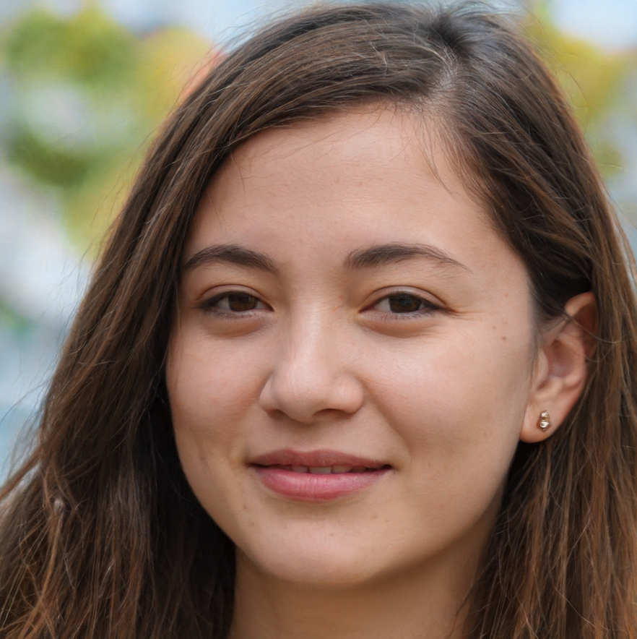
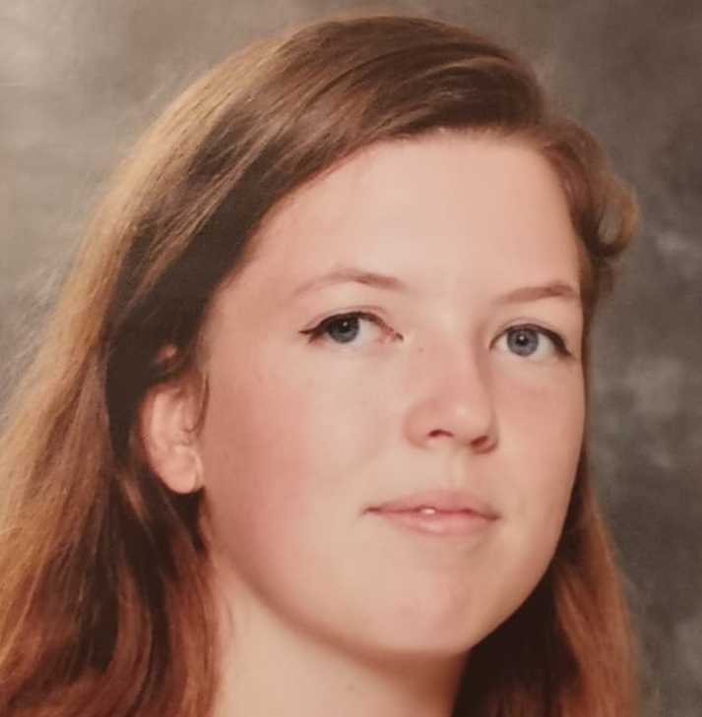
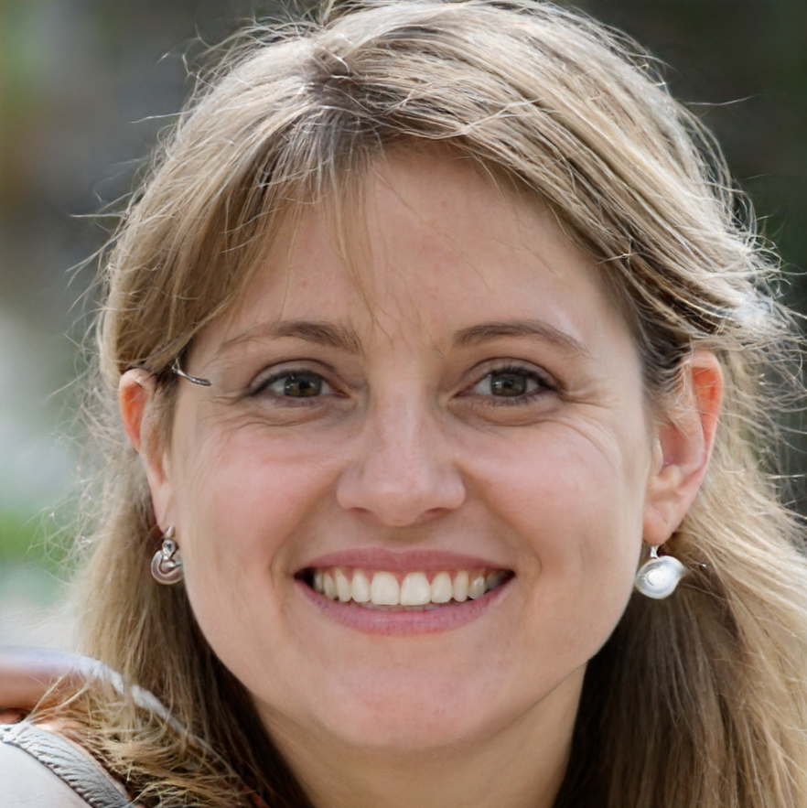

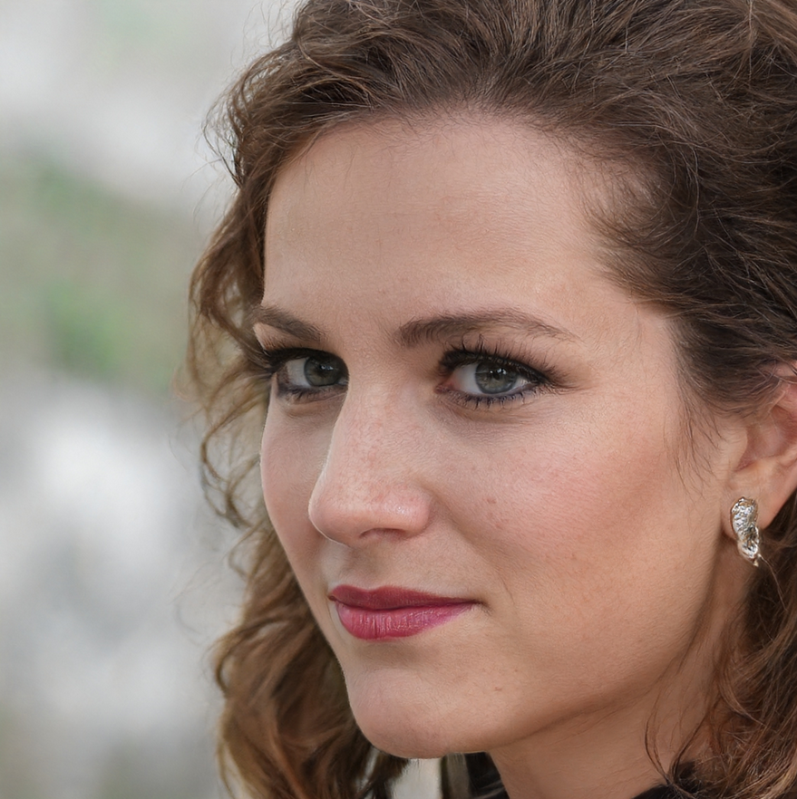

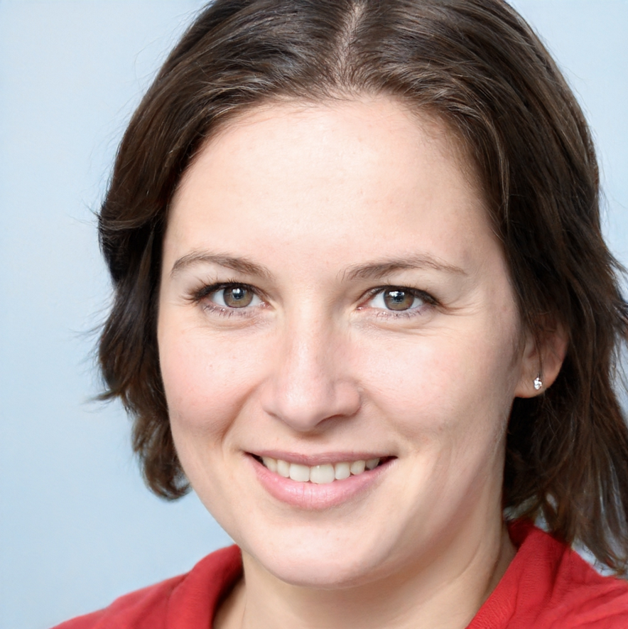
Does this person exist?

Slide 41


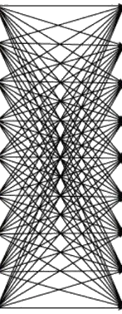
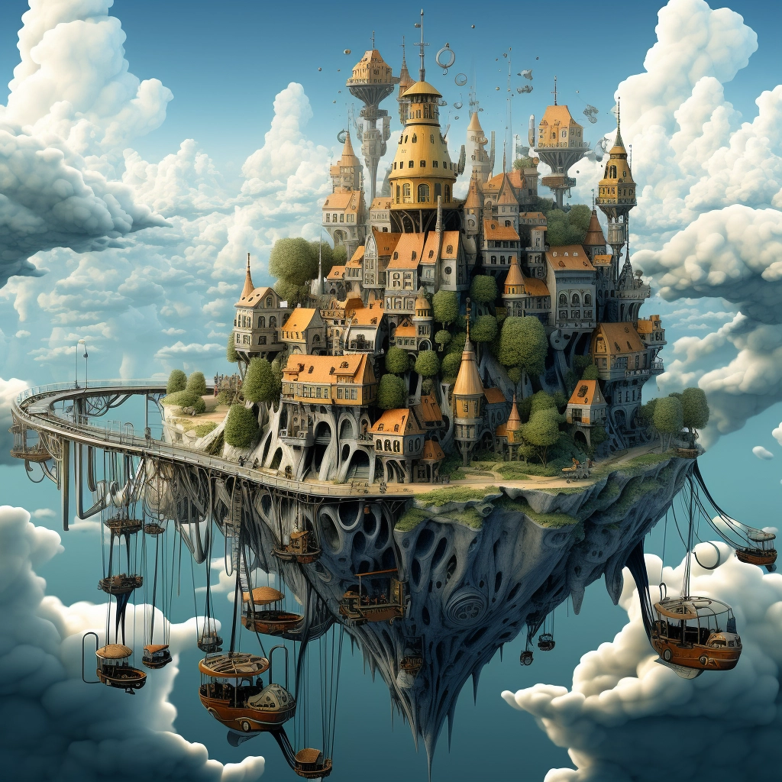
Generating images

Slide 42



What is a correctly generated image?
?
?

Slide 43


Use another AI!

Slide 44
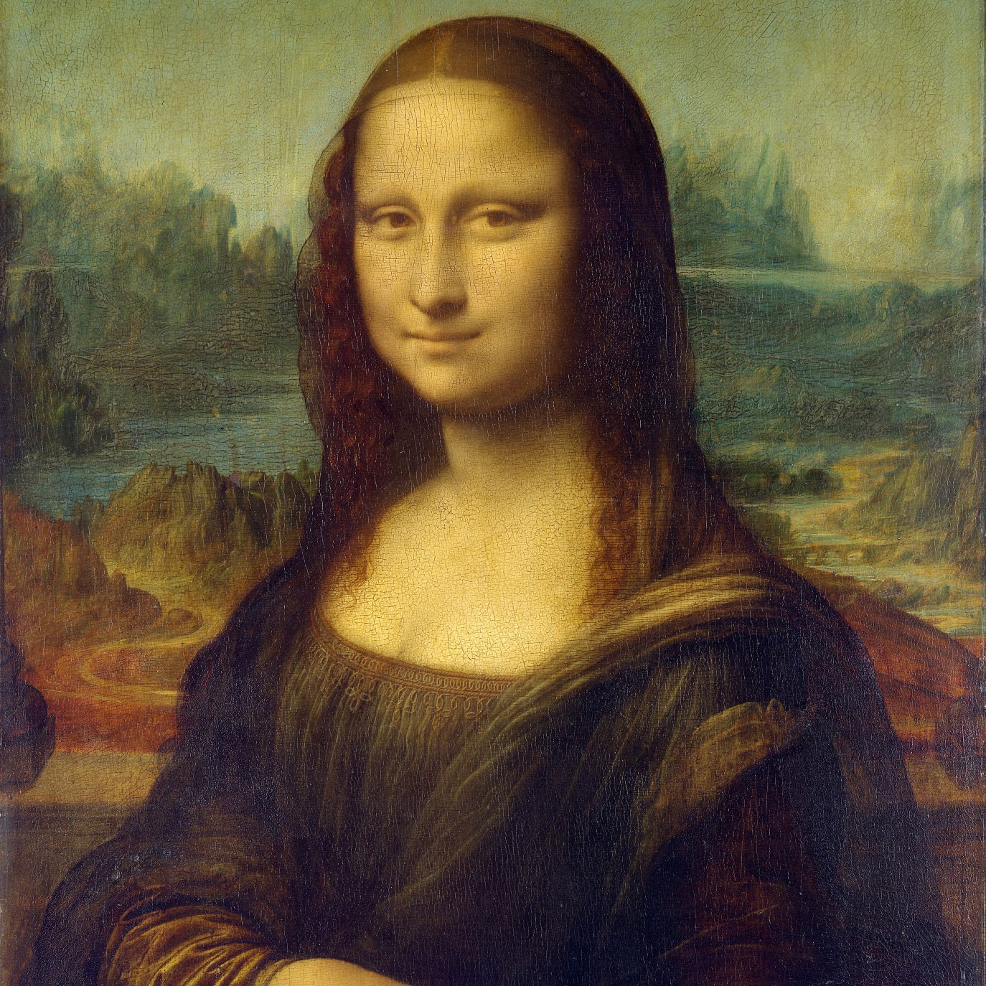
Use another AI!

Slide 45
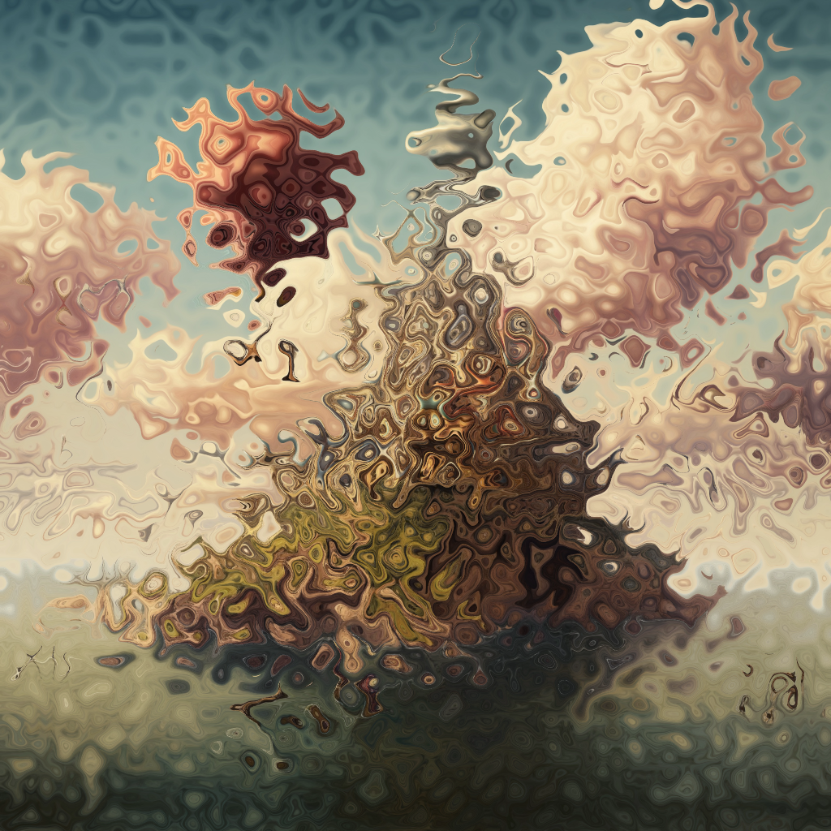
Use another AI!

Slide 46
Generating images training
?
?

Slide 47
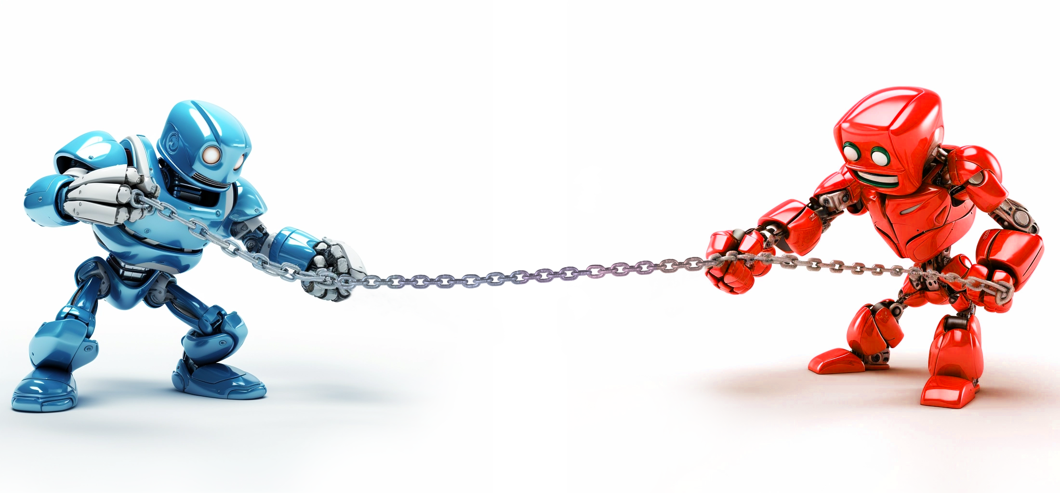
Generator vs Discriminator

Slide 48
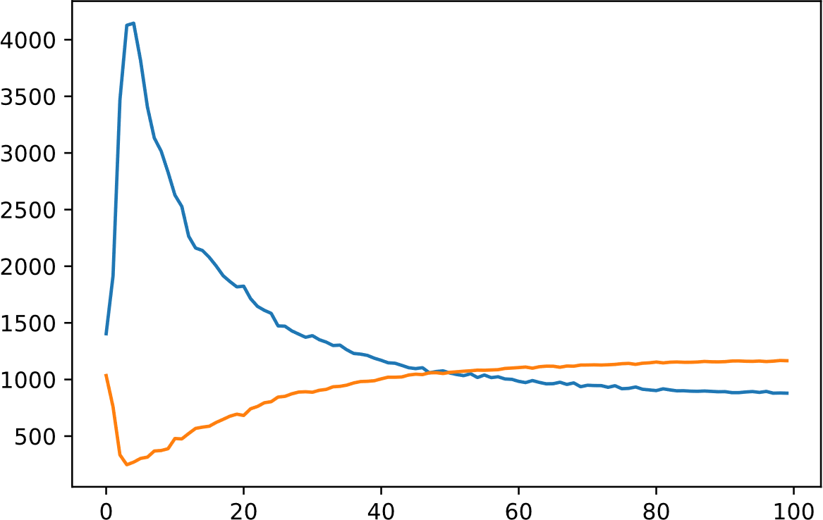
Generator vs discriminator
Training
Discriminator
Generator
Loss
Epochs

Slide 49


Draw a chick
https://pauldubois98.github.io/GenerativeAI/drawing_sandbox.html

Slide 50
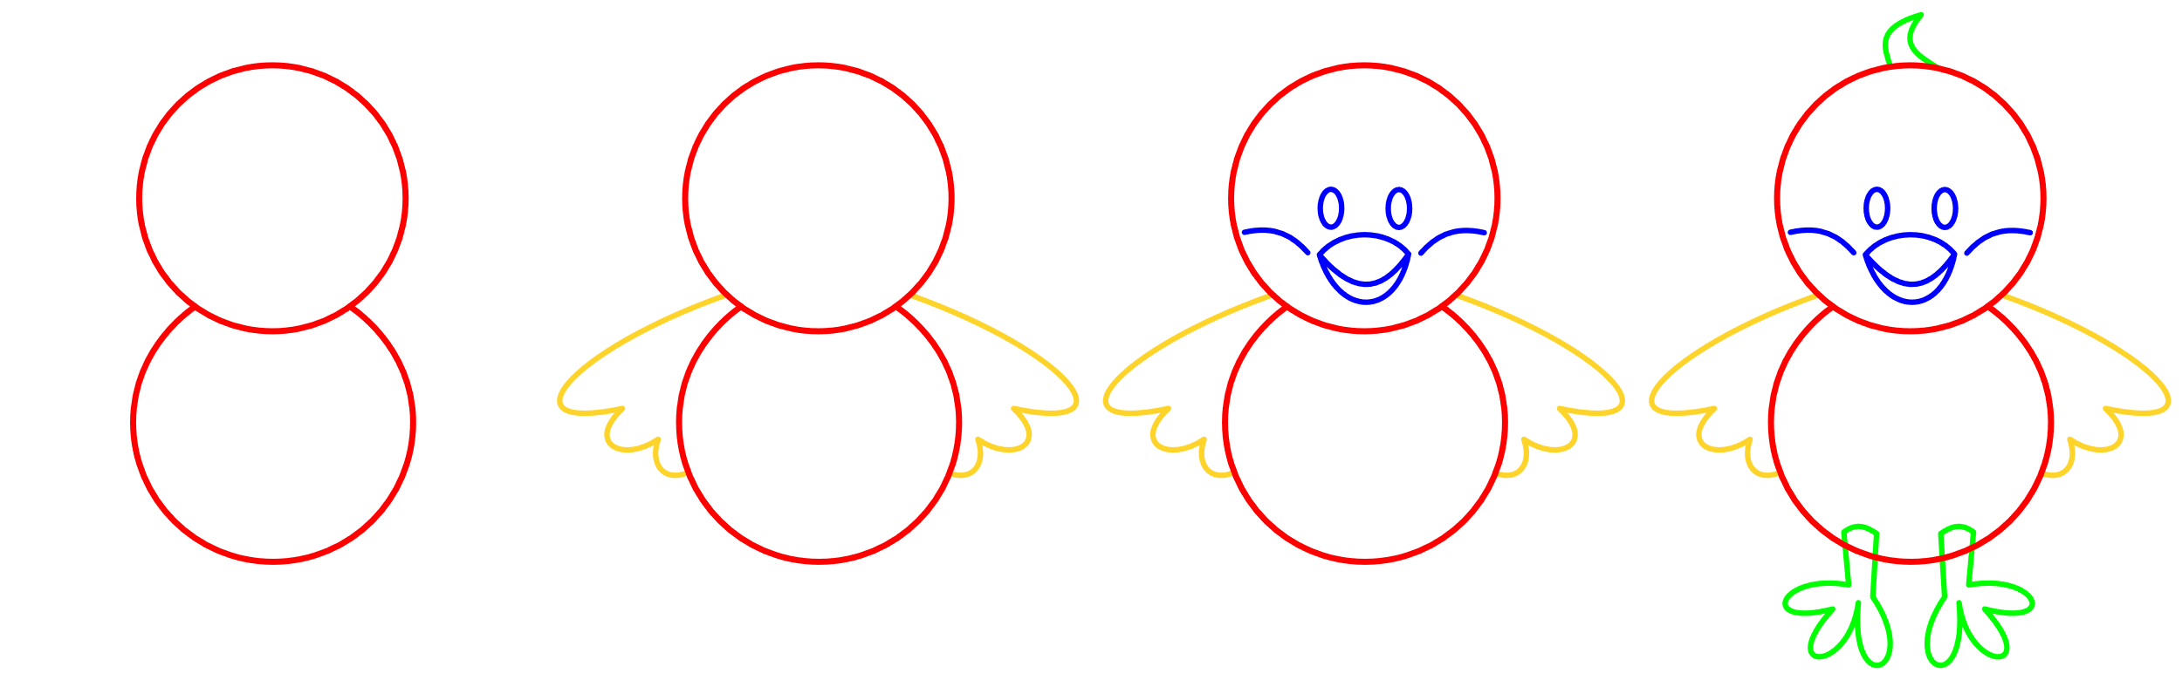
Draw a chick… with steps!

Slide 51

Denoising

Slide 52

Denoising

Slide 53

Denoising

